Slide 1
Multiple return lidar data analysis
Multidimensional Geospatial Modeling:
Lecture notes
Helena Mitasova, NCSU MEAS

Slide 2
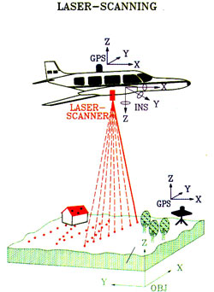
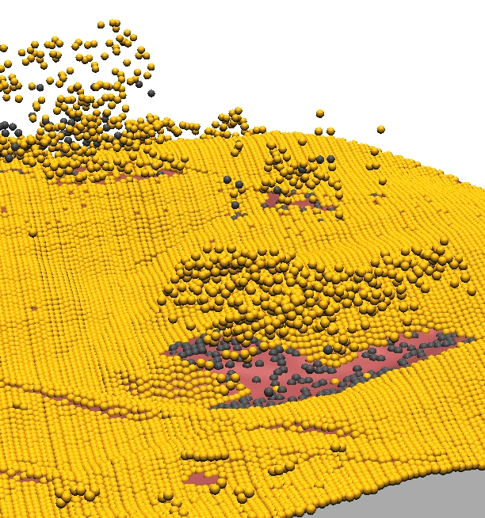
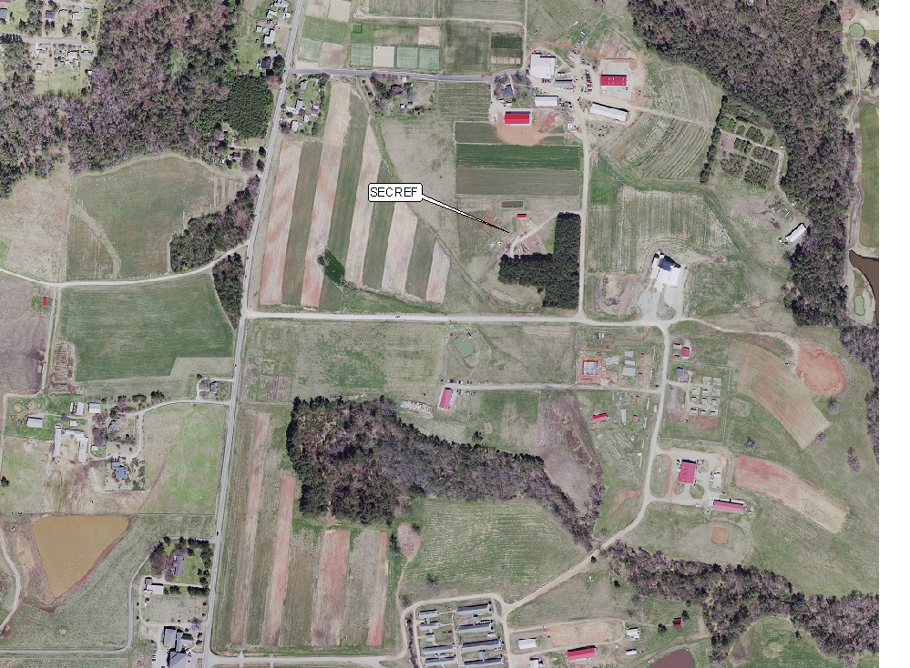
Airborne Remote Sensing
Sensors:
Data: x,y,z points
1 point per 0.3m
Orthophotography
0.15m resolution
Notes:
Intro: are any mapping technologies described? Surveying class and GPS class - CALS, forestry, CCEE?

Slide 3
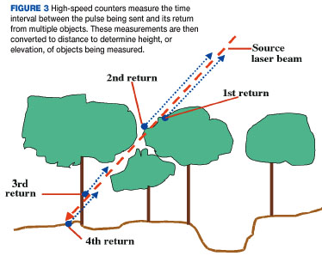
Point clouds
Multiple return point cloud data from 2001 NC Flood mapping program
Image from LIDAR primer, Geospatial solutions 2002
all returns
first return
Notes:
Intro - this has been already covered

Slide 4
Point clouds
see lecture by Michael Starek for more on filtering
Notes:
Intro - this has been already covered

Slide 5
Point clouds
Set of (x, y, z, r, i, c, ...) measured points reflected from Earth surface or objects on or above it, where x,y,z are georeferenced coordinates, r is the return number, i is intensity, c is class, r:g:b may be also measured
Provided in
ASCII (x,y,z, ...) format
binary LAS format (header, record info, x,y,z,i, scan dir, edge of flight line, classification, etc.), industry lidar data exchange format, often distributed as compressed LAZ format
http://grasswiki.osgeo.org/wiki/LIDAR
Notes:
Intro - this has been already covered

Slide 6
Point clouds
Processing:
filtering outliers (birds etc.)
bare earth point extraction
canopy extraction
structures and power lines extraction
Public data sources (http in Summary slide):
CLICK: raw point clouds usually in LAS format
NOAA Digital Coast: costal point clouds with on-fly binning
NC Floodplain Mapping: bare Earth: points, 20ft DEM and 50ft DEM with carved channels
OpenTopography: NCALM data
Notes:
Intro - this has been already covered

Slide 7
Point cloud analysis: binning
Binning: fast method for analyzing point clouds and generating DEMs using per-cell processing:
at least one point for each grid cell
analysis: number of points per cell, range, stddv
Methods for DEM: mean, min, max, nearest
sufficient for many applications
no need to import the points, on-fly raster generation
may be noisy, include no-data spots
Notes:
Intro - this has been already covered

Slide 8
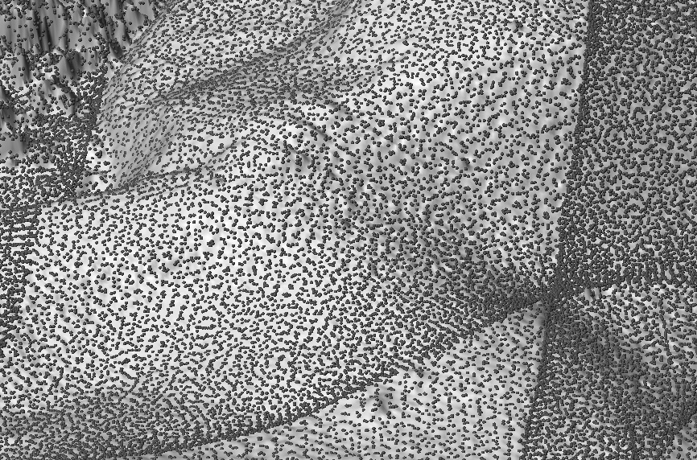
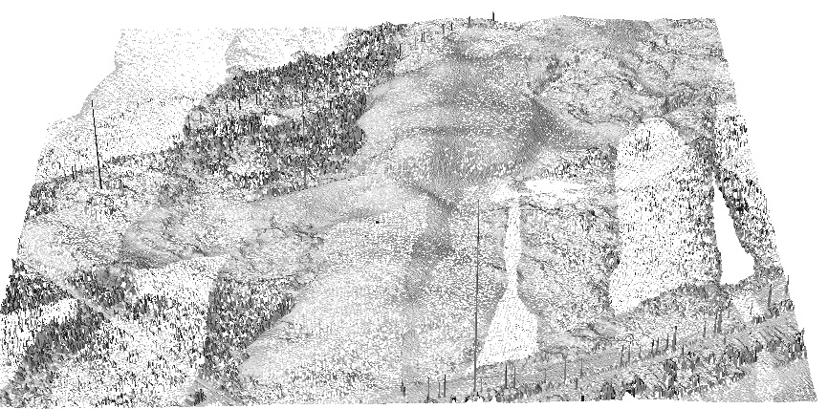
Lidar data examples: JR binning
Jockey's Ridge 1999, unfiltered single return lidar point cloud: 1m grid cell binning using maximum elevation
Result has many NULL cells – what to do?
Notes:
Intro - this has been already covered

Slide 9
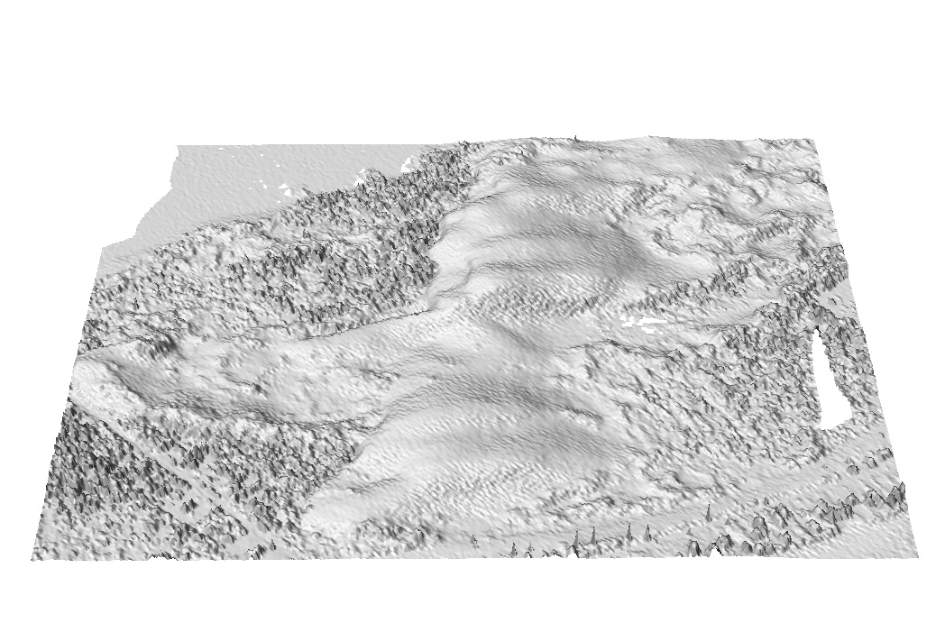
JR 1999 lidar: binning
3m grid cell binning: points to grid with method mean
Notes:
Intro - this has been already covered

Slide 10
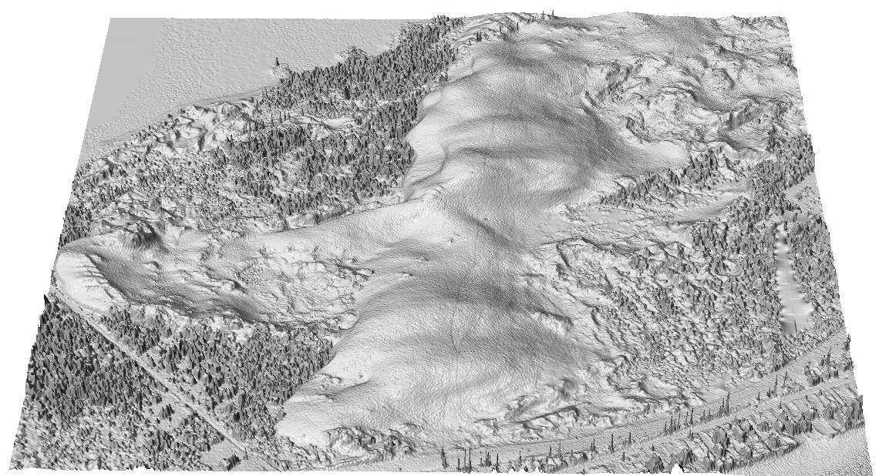
JR lidar: interpolated DSM
1m DEM interpolated by splines
Notes:
Intro - this has been already covered

Slide 11
Topo parameters from splines
Lidar data:
high resolution, noisy,
landforms represented by 10s or 100s of points or grid cells
Topographic analysis using 3x3 neighborhood often leads to noisy patterns of curvatures
Splines:
simultaneous computation of parameters with interpolation - based on the original points
tens or hundreds of points can be used
explicit equations for partial derivatives: RST
tuning the level of detail by tension and smoothing parameters

Slide 12
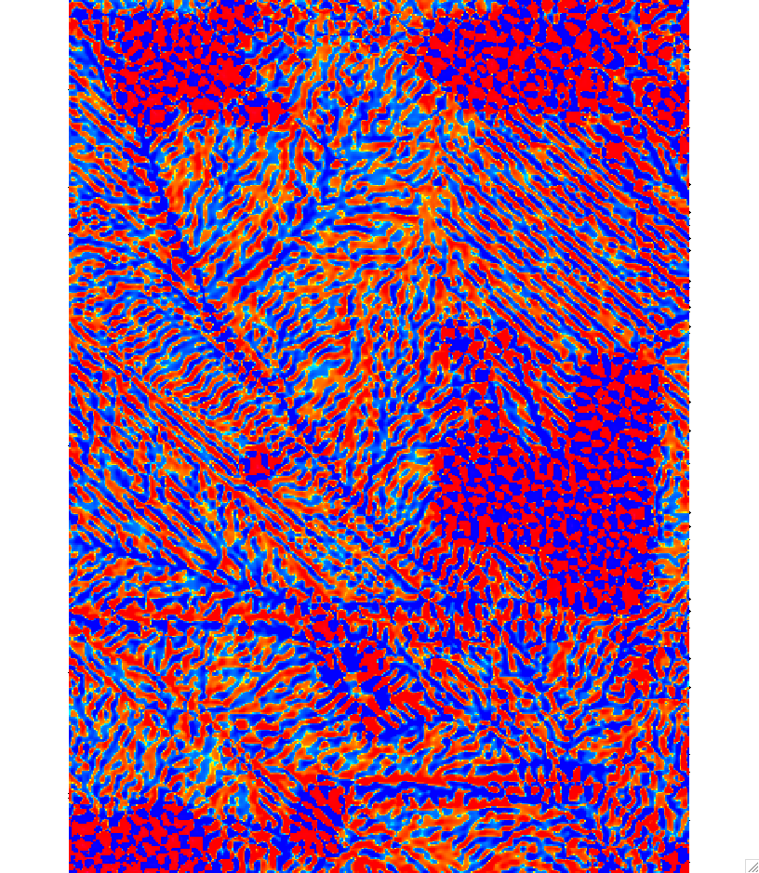
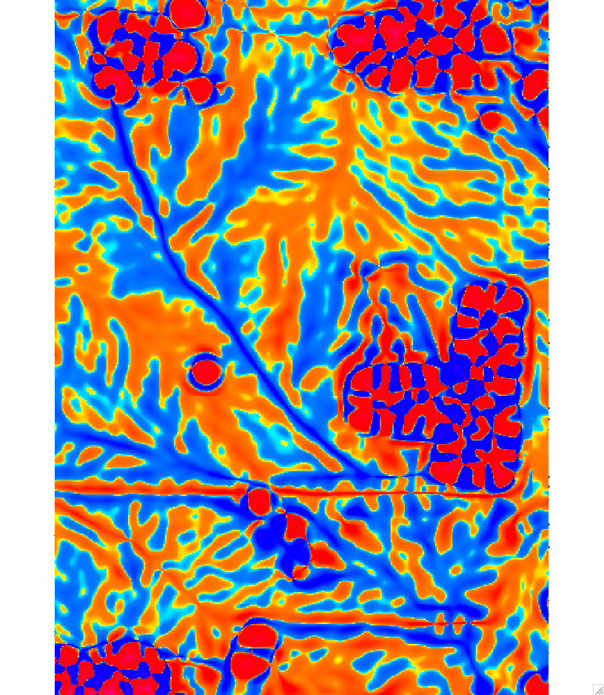
Topo parameters from splines
Tangential curvature at 1m resolution from multiple return lidar points
high tension low tension
same data - very different results !!!

Slide 13
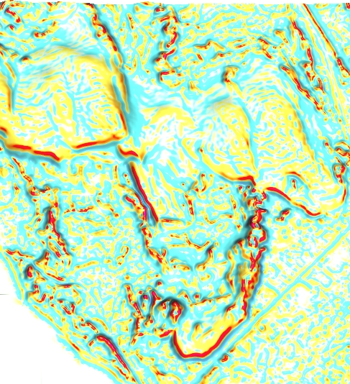
Crests extraction from curvature
Tune the spline to capture desired level of detail
Extract crests based on profile curvature threshold
tension:
high
low
40%
20
0
concave
convex
500m
profile curvature slope
Notes:
add animation for spline tuning

Slide 14
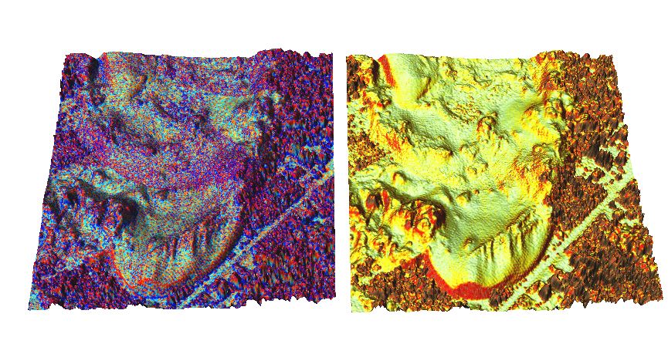
Tuning the spline tension
profile curvature slope
Notes:
add animation for spline tuning

Slide 15
Lidar data for Mamoth Cave Park:
Technology: waveform lidar
Data:
tile scheme
classified point cloud (EarthEye and las format) – run lasinfo
raw full waveform in lwv format
imagery

Slide 16
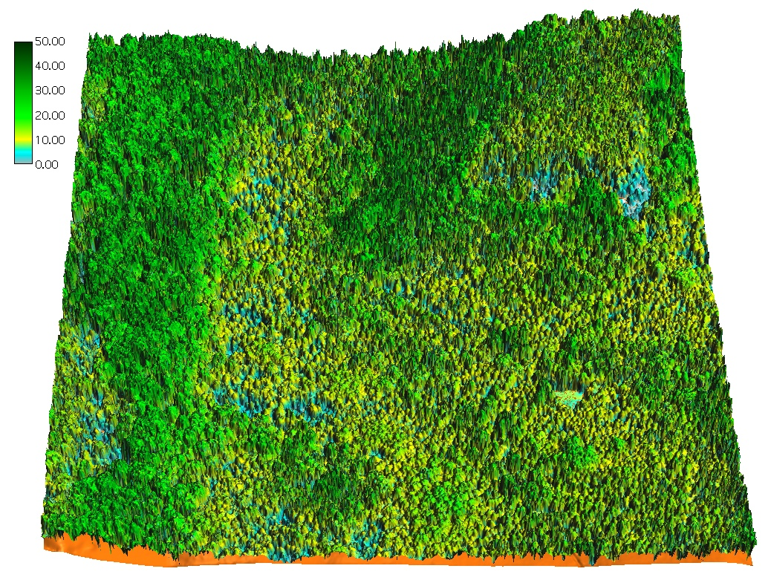
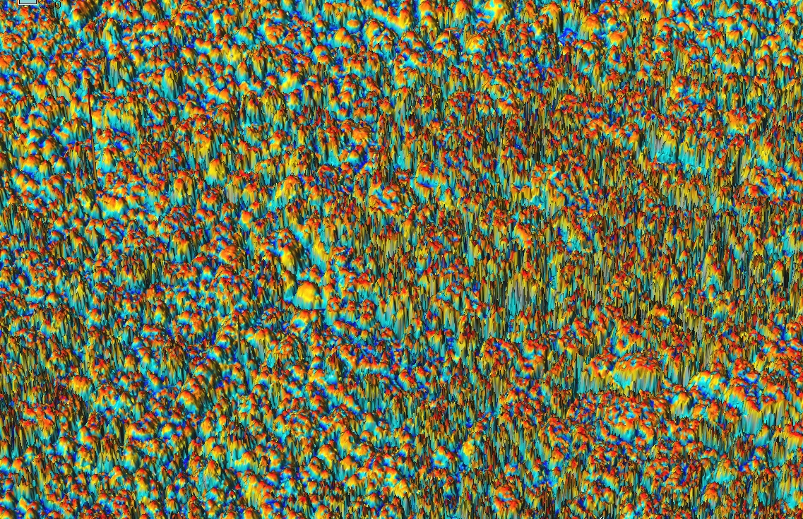
Mammoth Cave Park: Canopy
Profile curvature
of the first return surface
Canopy height
Notes:
add animation for spline tuning

Slide 17
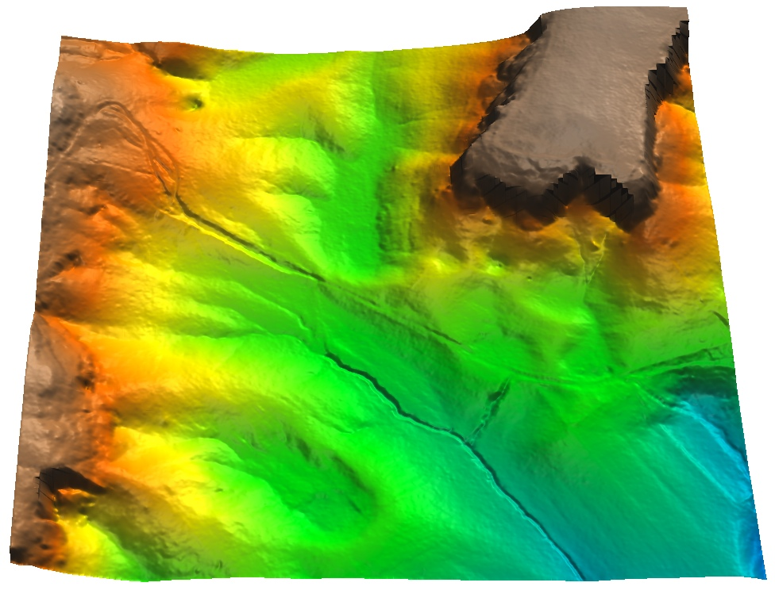
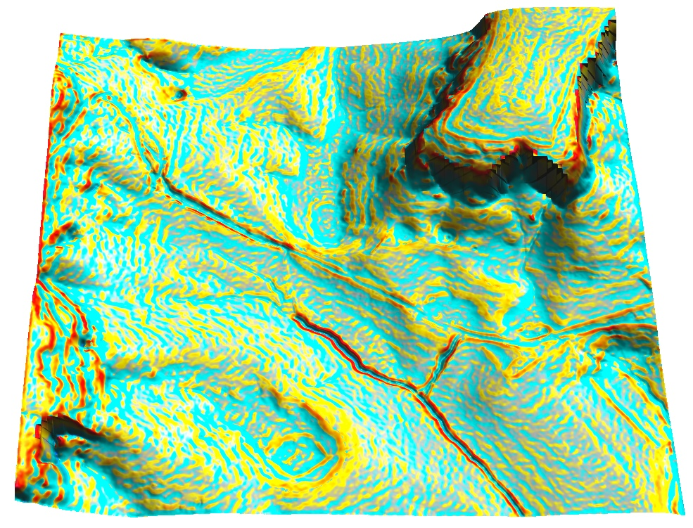
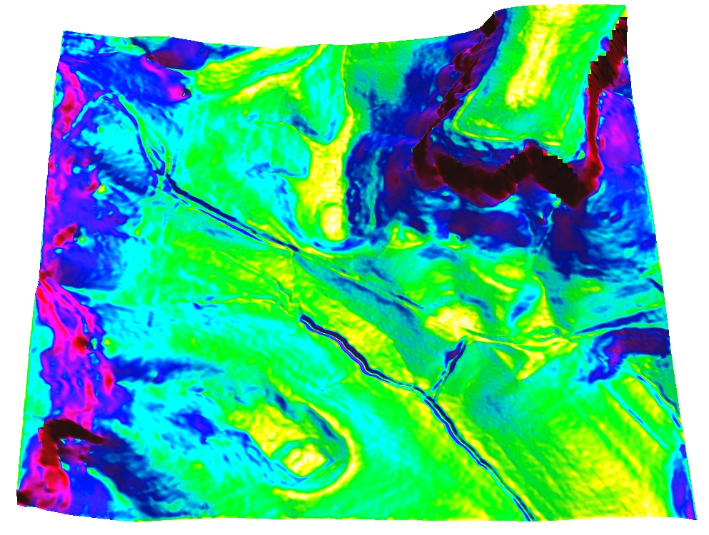
Mammoth Cave Park
bare earth elevation
profile curvature
bare earth slope
Notes:
add animation for spline tuning

Slide 18
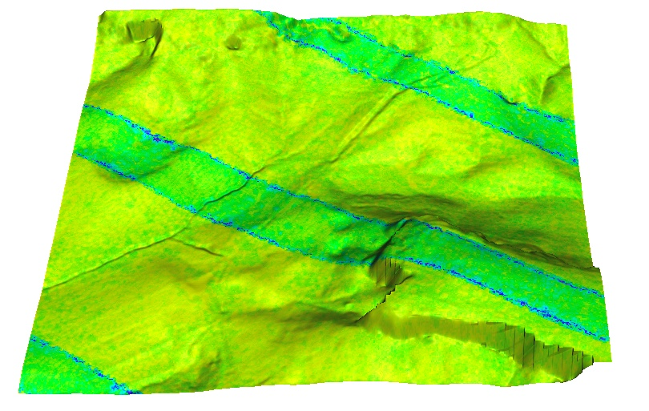
Mammoth Cave Park
Number of points per cell
Notes:
add animation for spline tuning

Slide 19
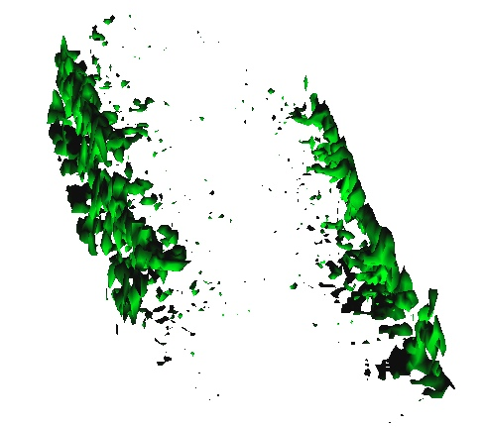
Indian Hill: 3D point density
Binning into voxel models
Isosurfaces of 30points/1m cell,
0-24m above ground
All point density in top of
Indian Hill
Bare ground
with canopy surface
crossection
Notes:
add animation for spline tuning

Slide 20
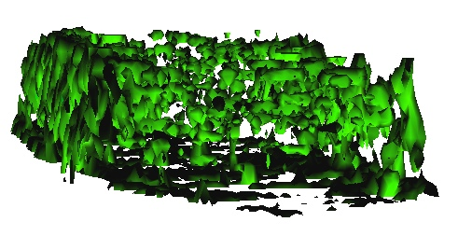
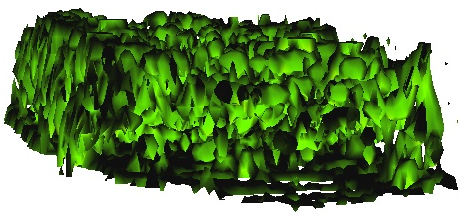
Indian Hill 3D point density
Isosurfaces of 20 points/1m cell
0-24m above ground
Isosurfaces of 15 points/1m cell
0-24m above ground
Bare ground
with canopy surface
crossection
Notes:
add animation for spline tuning

Slide 21
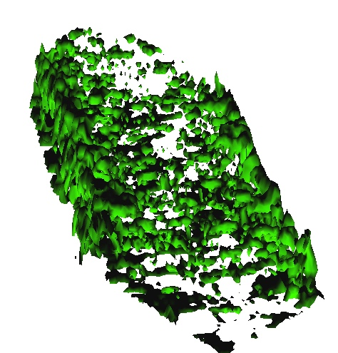
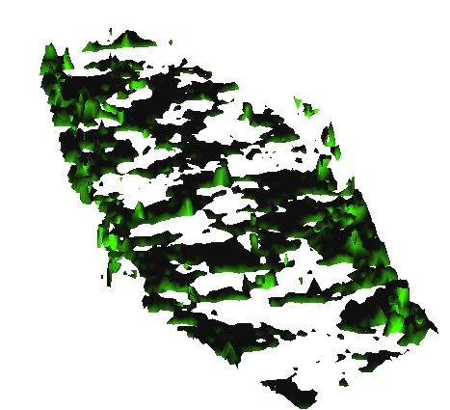
Mammoth Cave Park: Canopy
Isosurfaces of
20 points/1m cell
at 4m and 20m
height above ground
Notes:
add animation for spline tuning

Slide 22
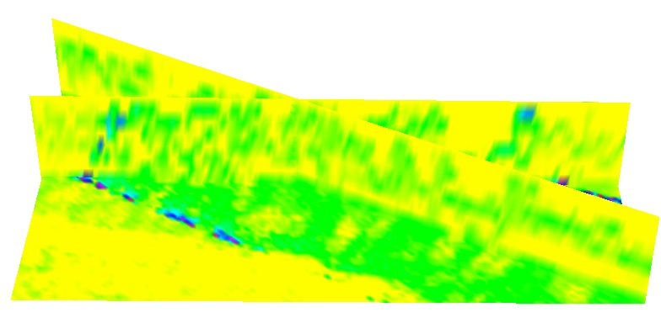
Mammoth Cave Park: Canopy
Slices
24m
0m
Notes:
add animation for spline tuning

Slide 23
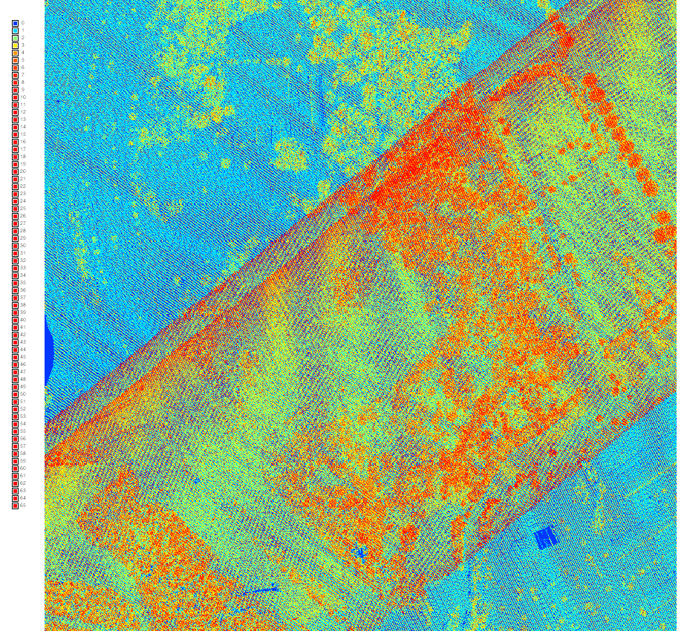
Lidar data examples: 2013 Raleigh
Number of all return and bare earth points in each 1m (3ft) cell
0793_016.las tile point densities
Notes:
Intro - this has been already covered

Slide 24
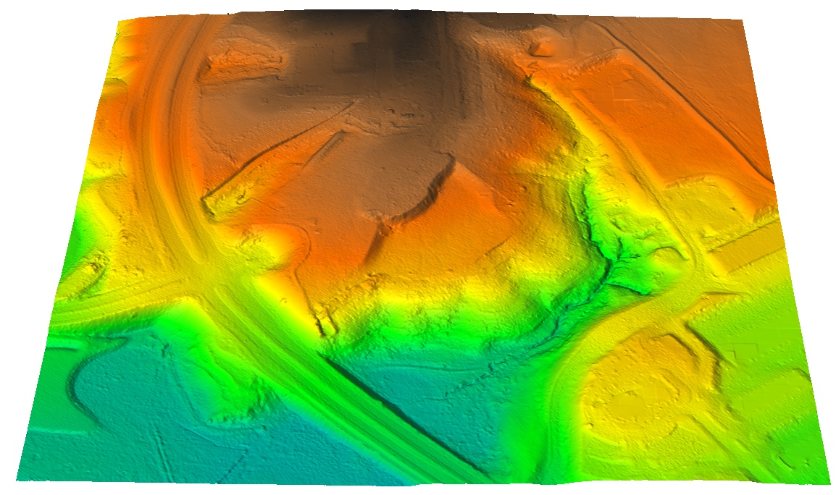
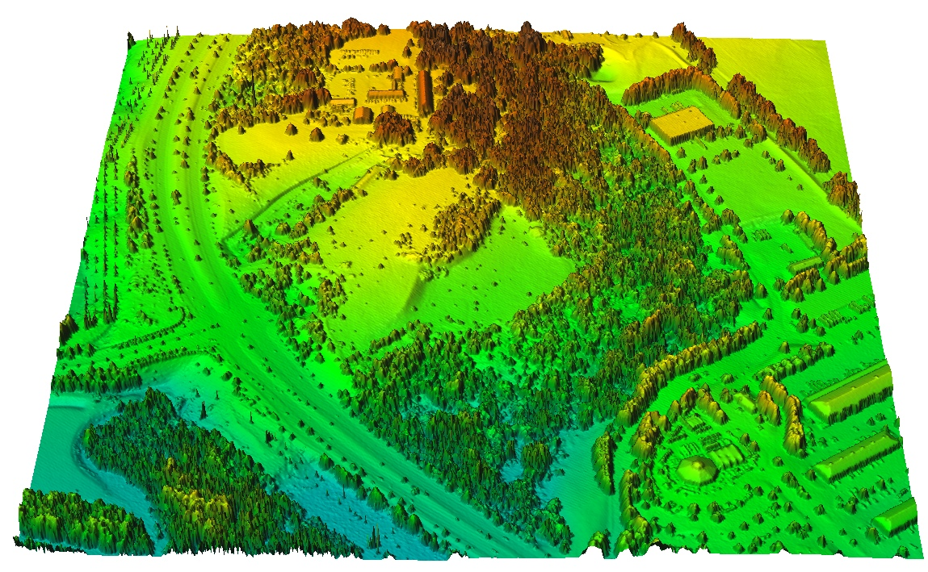
Lidar data examples: 2013 Raleigh
interpolated bare earth
and first return surfaces
Notes:
Intro - this has been already covered

Slide 25
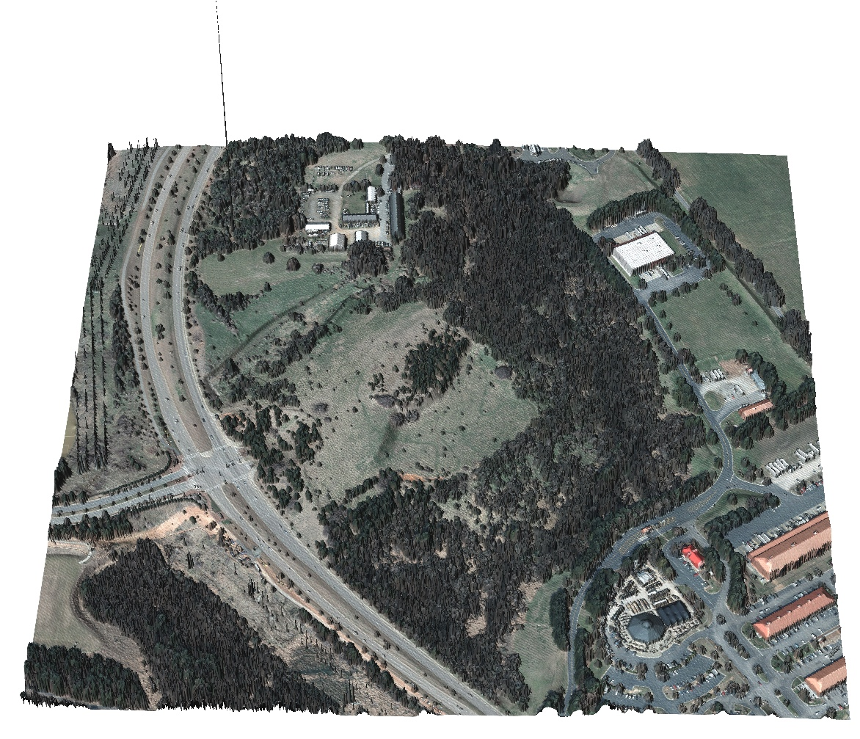
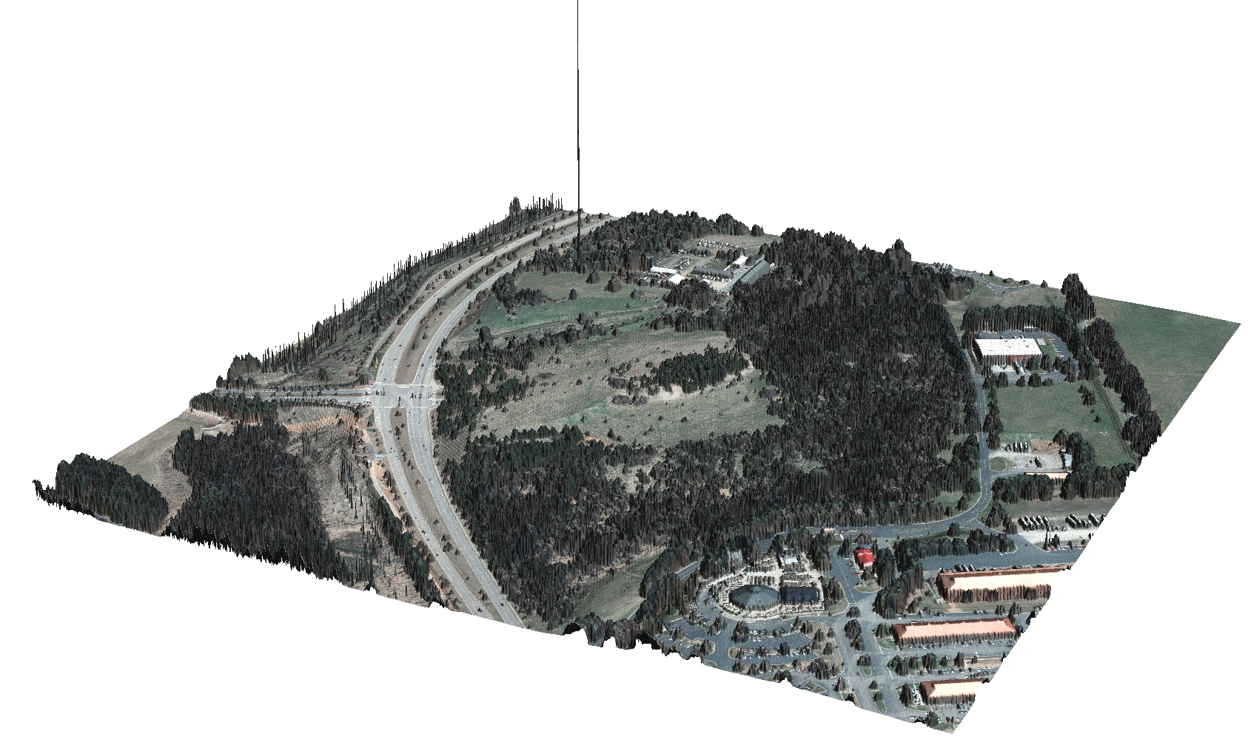
Lidar data examples: 2013 Raleigh
interpolated first return surface with orthophoto draped
over it: note the outlier and power lines
Notes:
Intro - this has been already covered

Slide 26
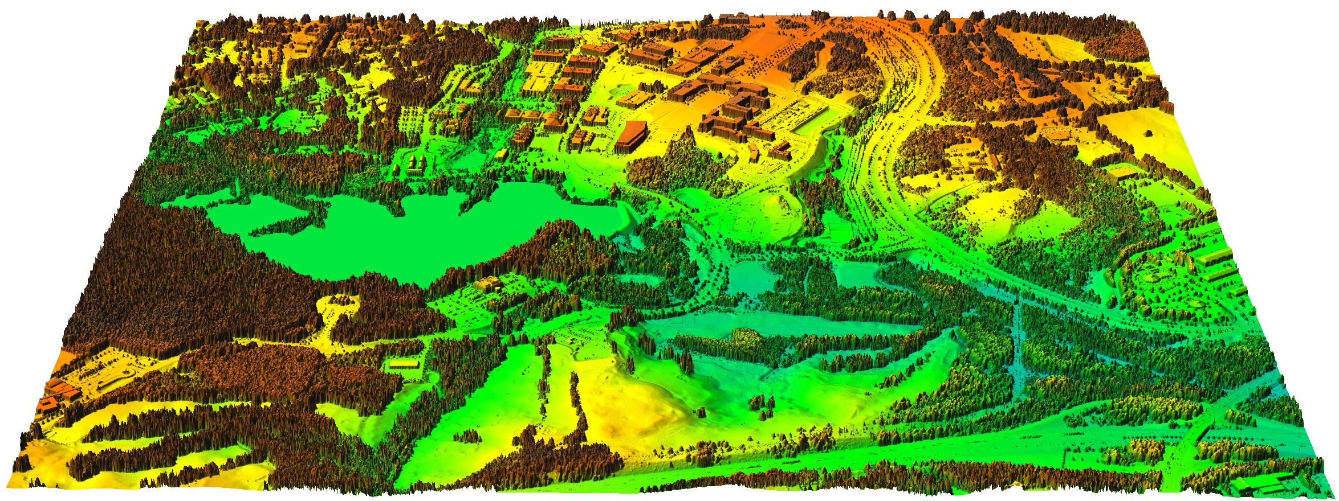
Lidar data examples: 2013 Raleigh
Notes:
Intro - this has been already covered

Slide 27
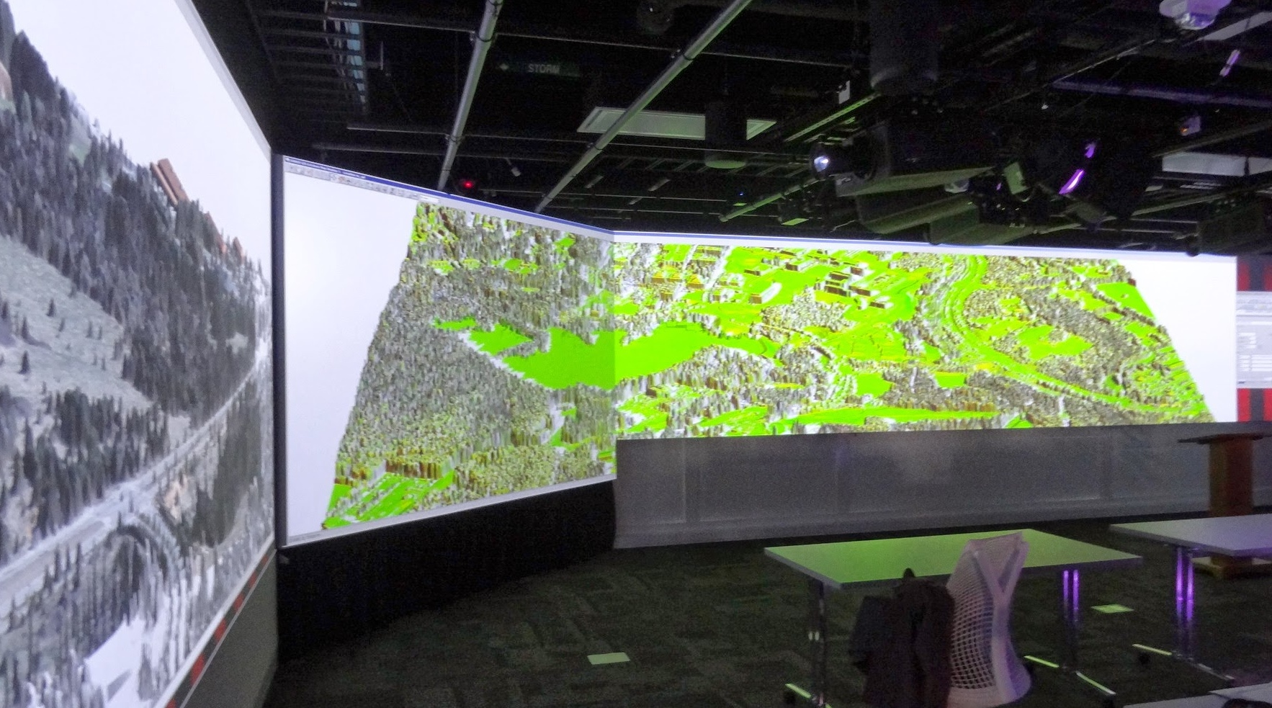
Lidar data examples: 2013 Raleigh
Notes:
Intro - this has been already covered

