Slide 1
Exploring topographic change impacts using tangible interface.
Helena Mitasova, Brendan Harmon,
Anna Petrasova, Vasek Petras,
North Carolina State University, Raleigh, NC, USA
Bruce Blundell, US Army Topographic Engineering Center
GRASS GIS
Notes:
TITLE OF THE SESSION: Geological and Geomorphological Applications of Digital Terrain Analysis
We present new advances in the development of Tangible Geospatial Modeling System (TanGeoMS),an exploratory environment for analysis of relationships between elevation surface morphology and landscape processes. The system integrates digital terrain dataand a flexible physical model with GRASS GIS-based analysis and simulation tools.
The physical model can be modified by hand and scanned to create digitalrepresentations of altered landscapes within a GIS.
The results of topographic analysis and GIS-based simulationsapplied to the modified landscape are then projected over the physical model,
providing the users with feedback about the impact of the changes on the terrain parameters or modeled processes.
The new prototype system replaced the costly laboratory laser scanner with a kinect-based solution, making the system affordable, lighter and more flexible,
while providing adequate accuracy and scanning speed.Advances in 3D printing and new modeling materials extended the techniques
for building the physical models from a carved foam with plasticine surface to3D printing or moulding from polymer-enriched sand for rapid 3D sketching.
We demonstrate the system applications for analysis of terrain change impactson selected processes in natural and engineered landscapes, and for
testing simulation algorithms in various landscape configurations.The examples include overland water and sediment transport patterns modeled by standard flowrouting and unit stream power based method andby a robust particle sampling algorithm. Coastal terrain inundation and dynamics of solar irradiation under changing topographic conditions is also explored.The demonstration examples highlight the TanGeoMS application for collaborative explorations, communication of terrain change impacts and testing of algorithms for land surface process simulations.

Slide 2
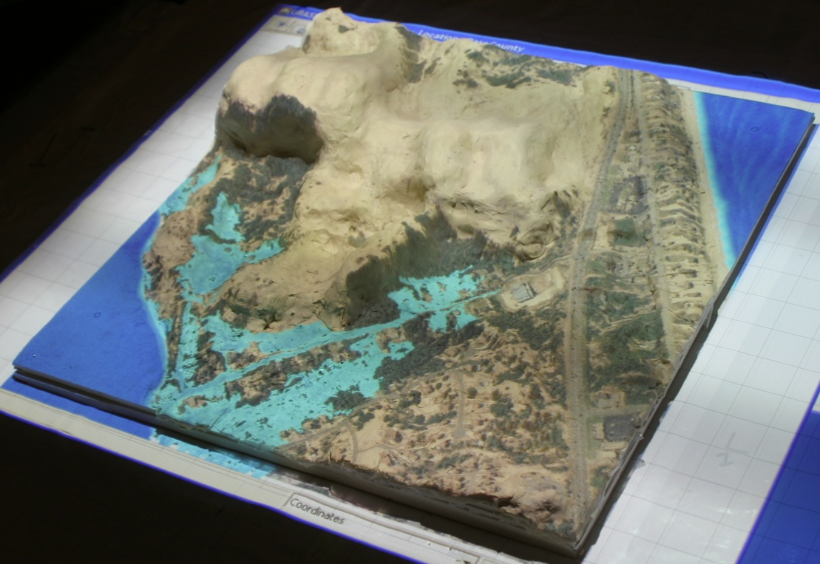
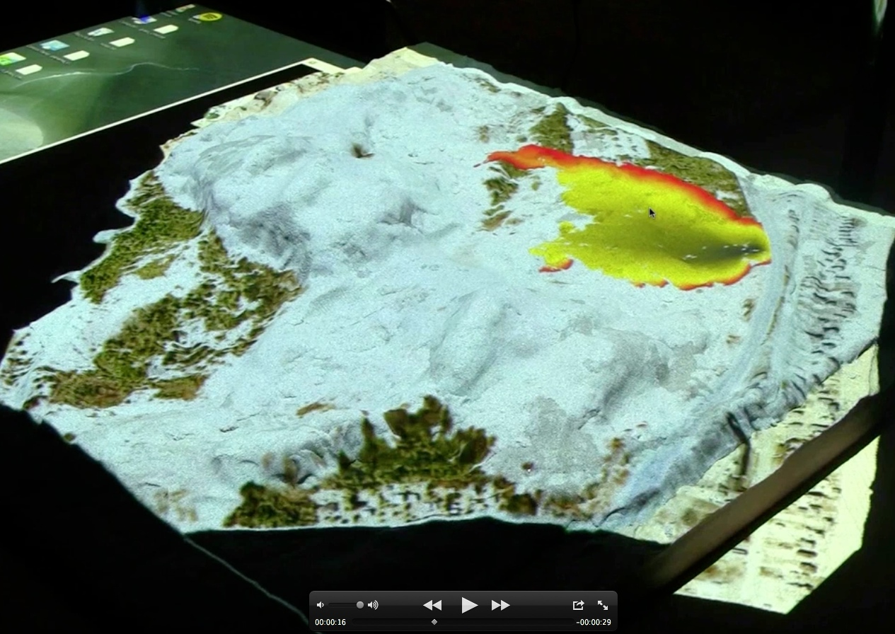
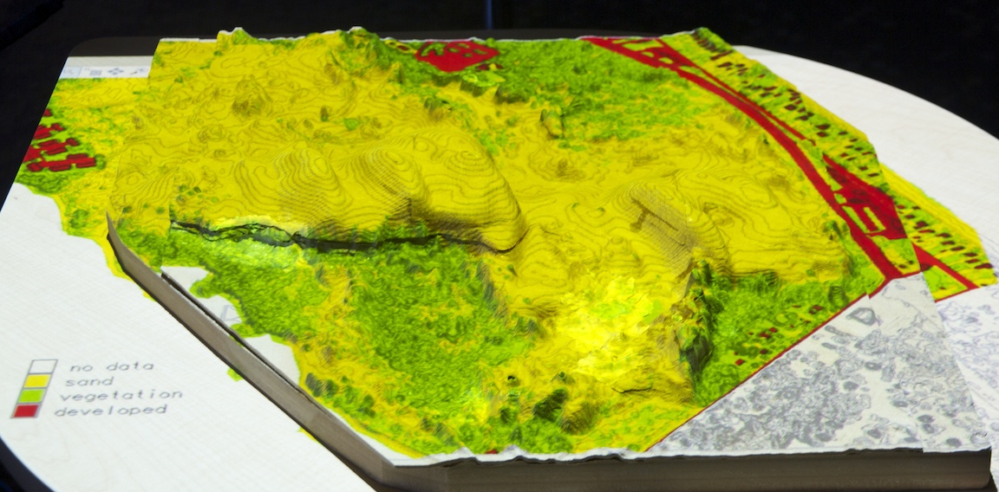
Visualization on 3D physical models
flooding fire
Projecting GIS data and simulations over 3D landscape models:
visualize and communicate relation between topography and processes
land cover

Slide 3
GIS and 3D Models: One-way Coupling
Computer
Physical model
projector
color: data, simulations
GIS
surface: elevation

Slide 4
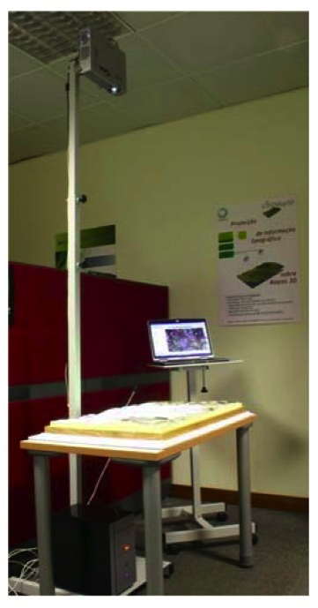
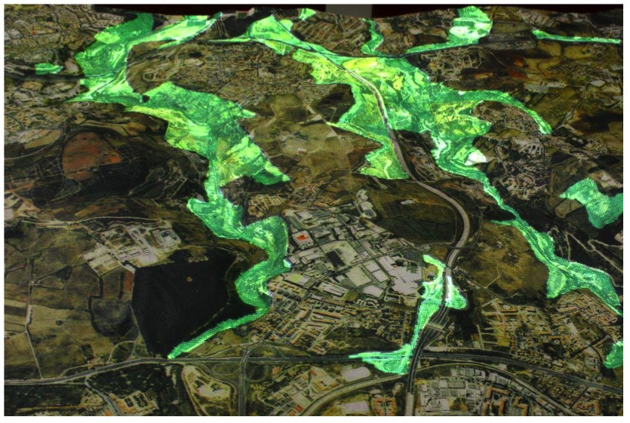
Early systems
GIS2MAP3D
presented at GISPlanet
in Portugal

Slide 5
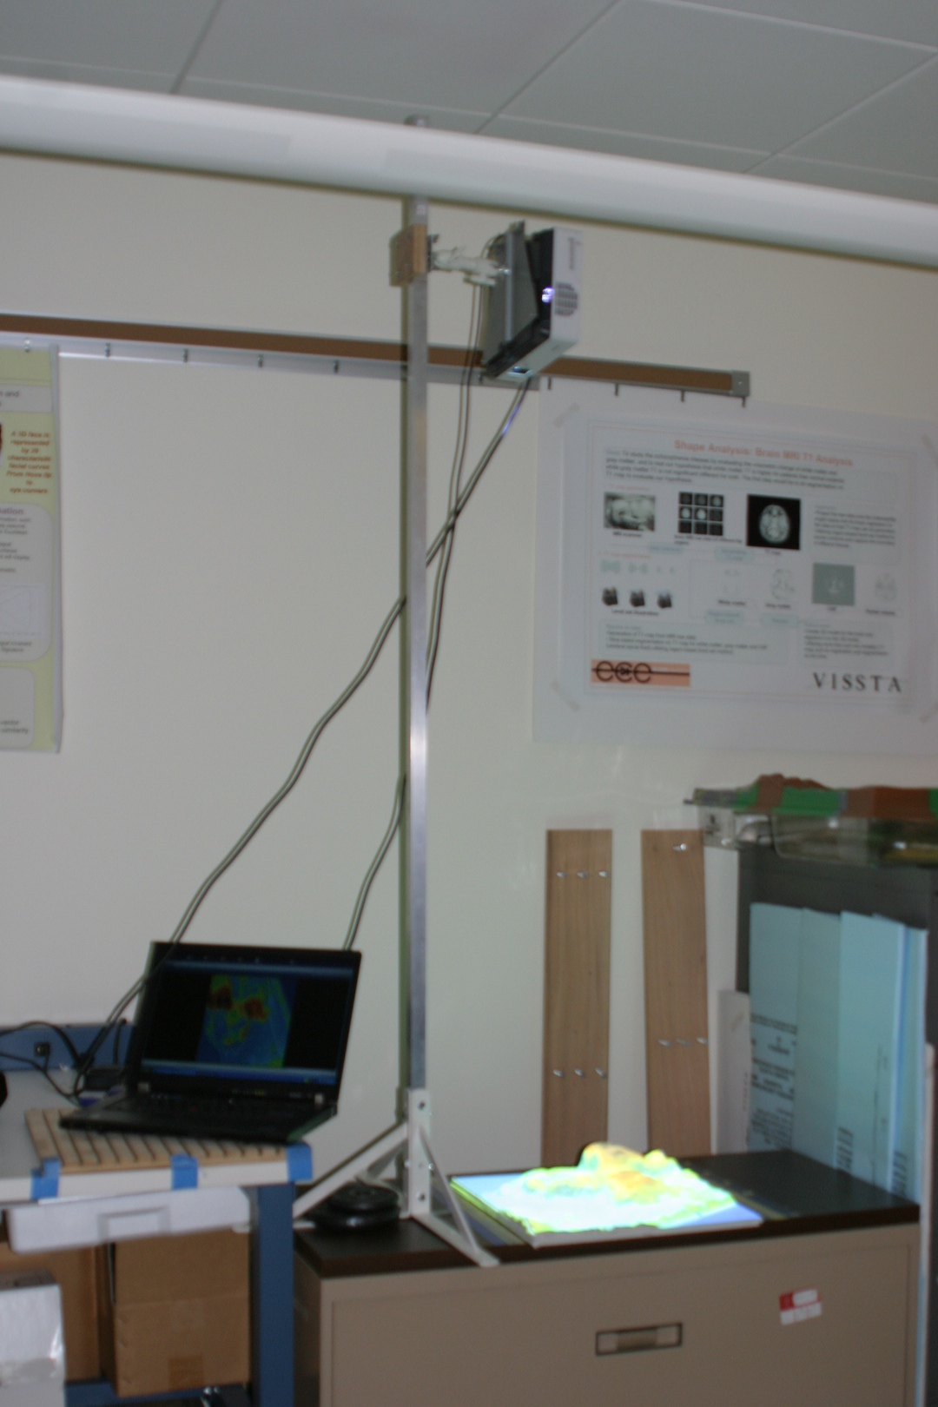
Mobile demo system
Mobile demo system
developed by Brent Fogleman
presentation at Geomorphology
conference in South Carolina
by Katie Weaver

Slide 6
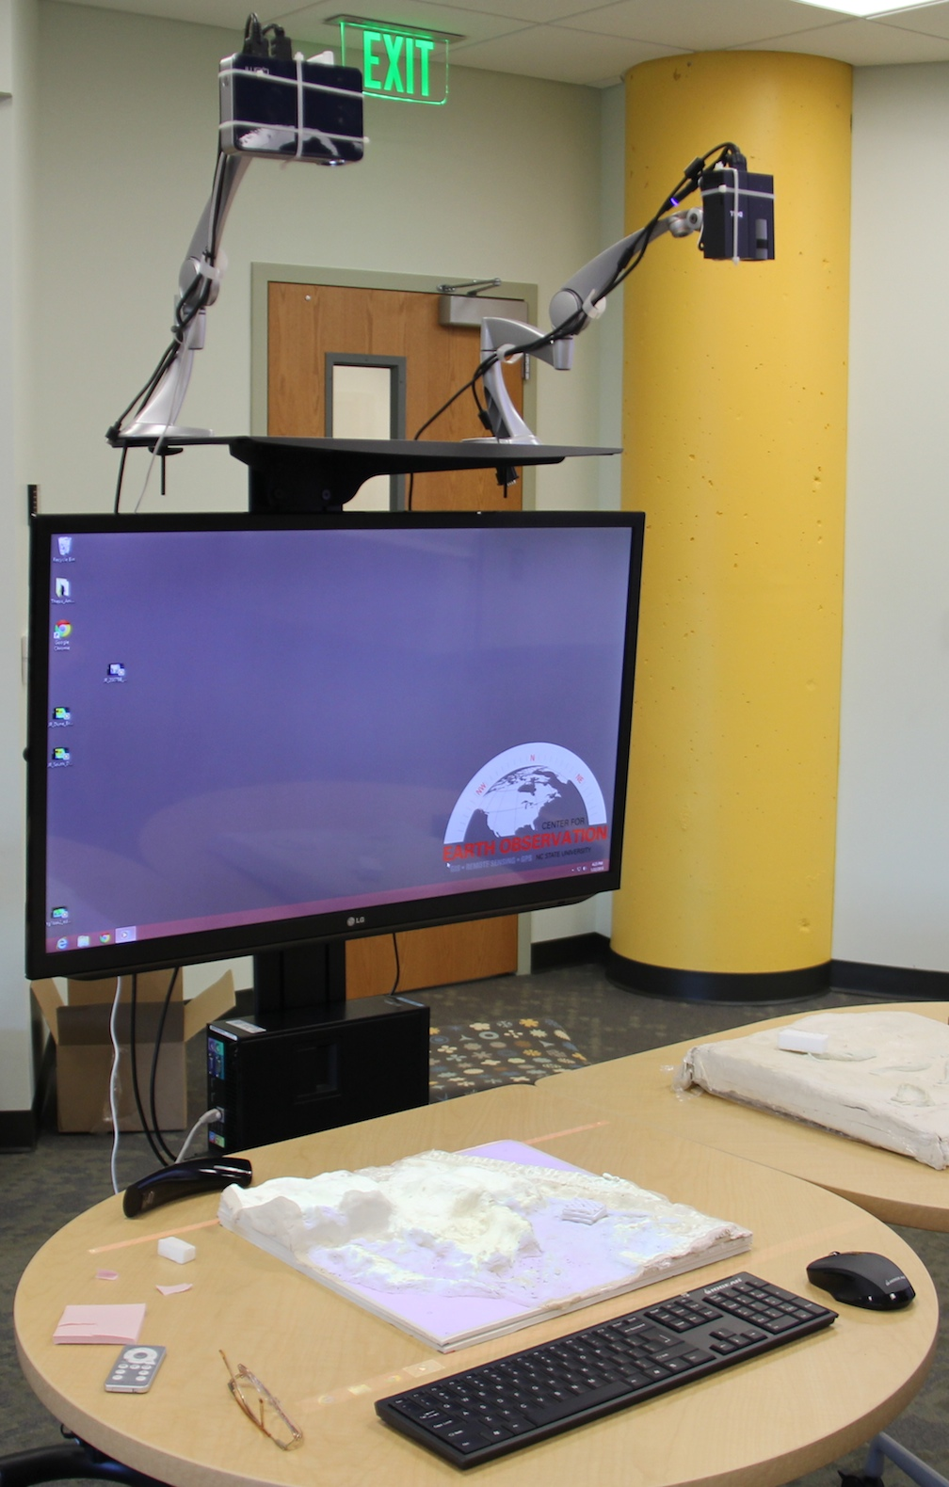
Classroom system for two models

Slide 7
Creating 3D models: centuries old tradition

Slide 8
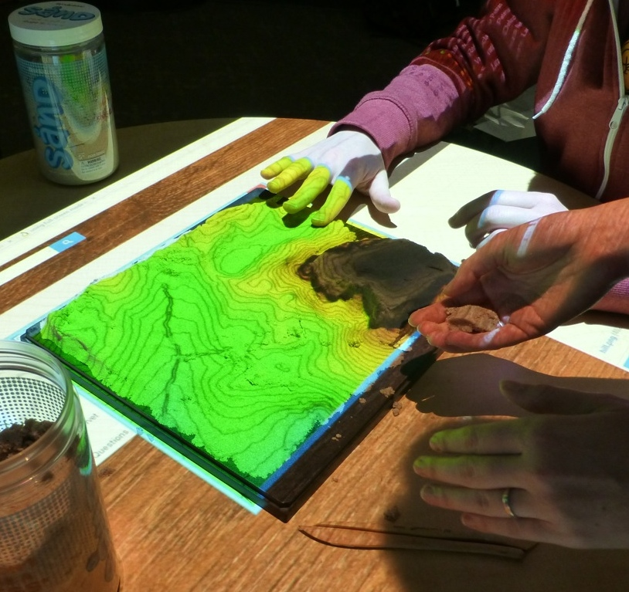
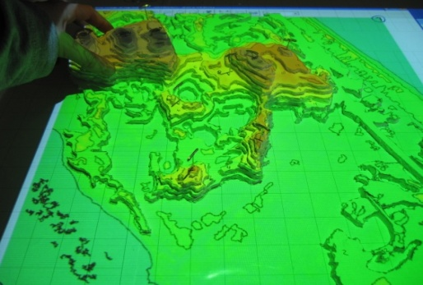
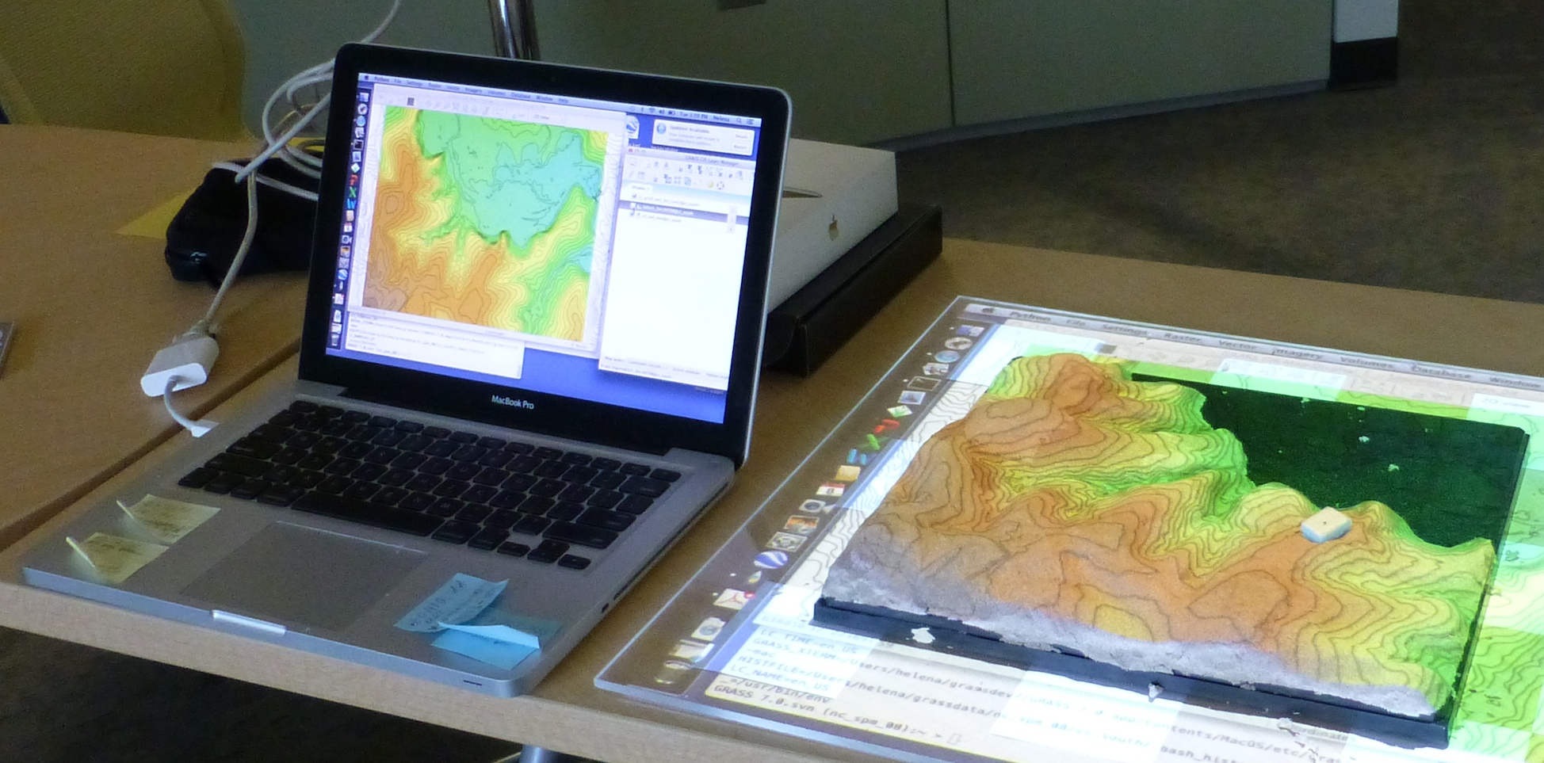
Creating 3D models: manual
Creating model based on projected contours and DEM – model differencing
Clay on carved foam
Polymer enriched sand:
creating model based on projected contours and DEM differencing

Slide 9
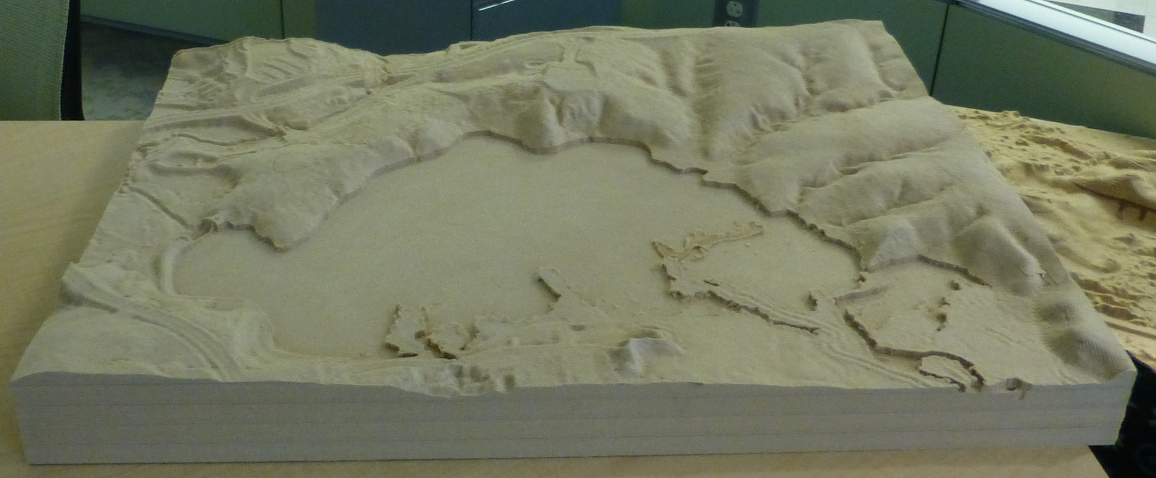
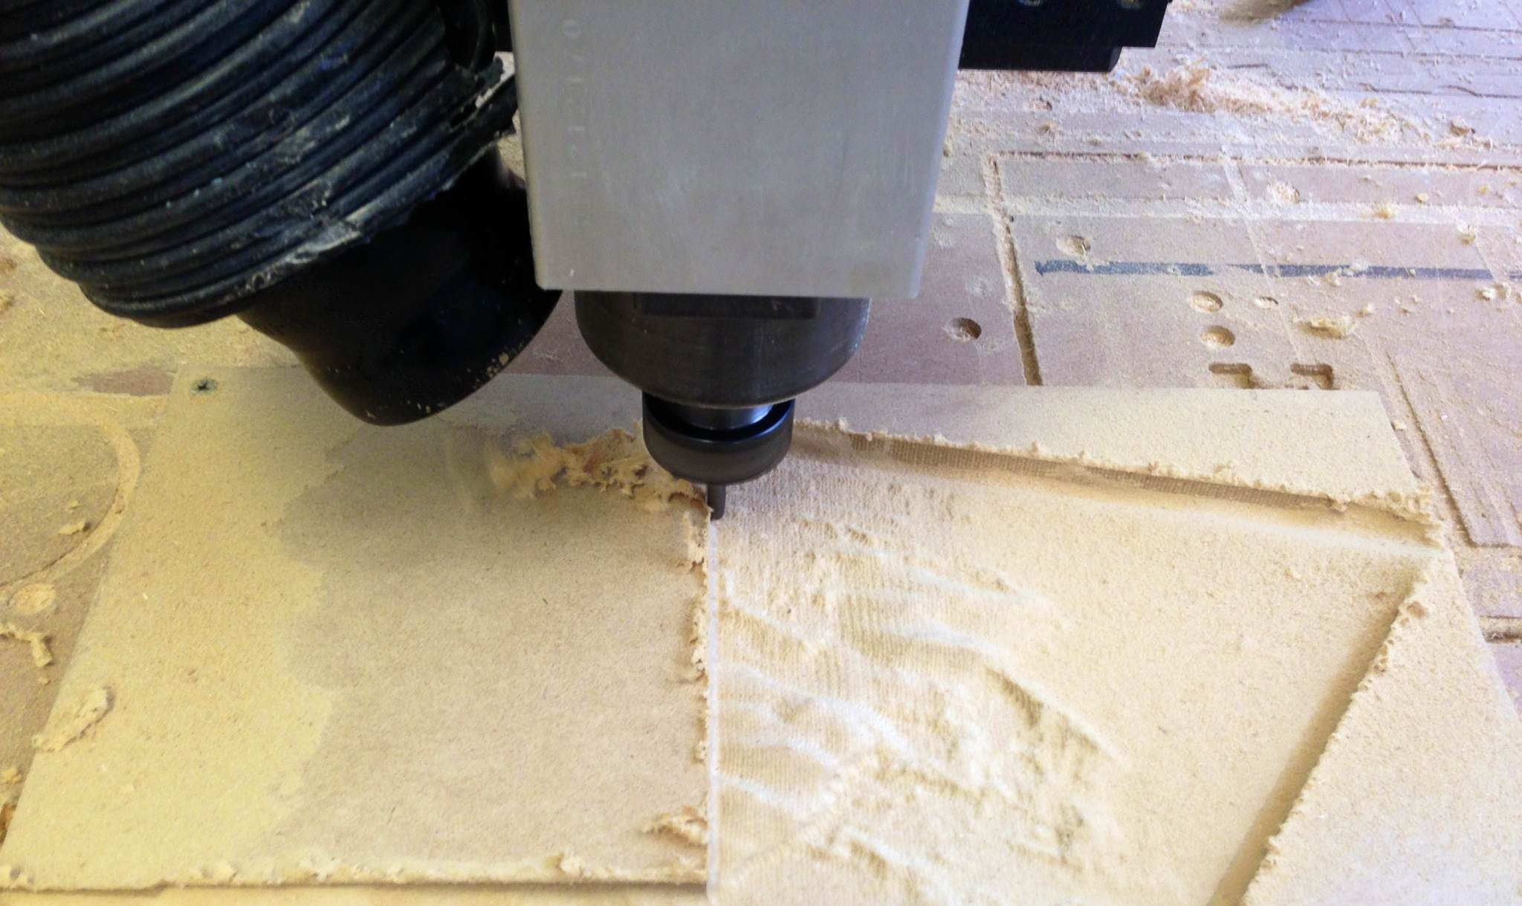
Creating 3D models: automated
CNC routers:
wood dust composite
GIS > xyz
> Rhino CAM > NC file
Notes:
STL stereo lithography
CNC computer numeric controlled
CAM computer aided manufactiring

Slide 10
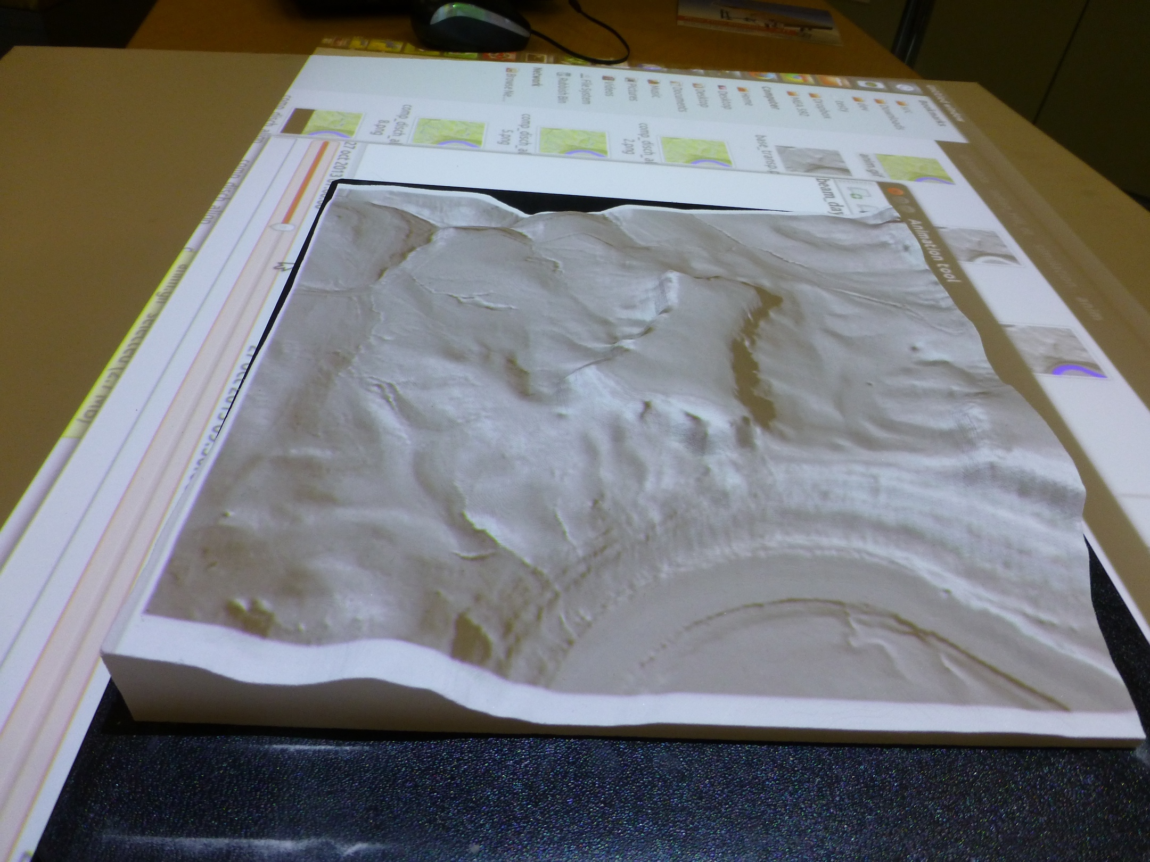
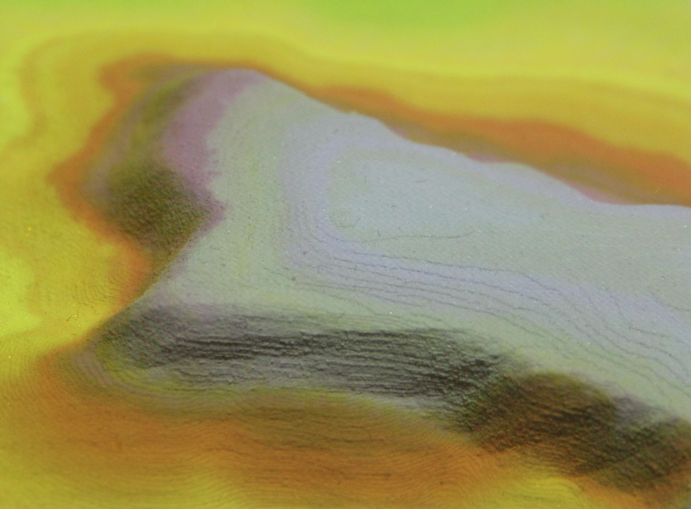
Creating 3D models: automated
3D printing:
GIS > xyz > Rhino Terrain > closed surface > STL
Z-printer
white gypsum bound with starch
Notes:
STL stereo lithography
CNC computer numeric controlled
CAM computer aided manufactiring

Slide 11
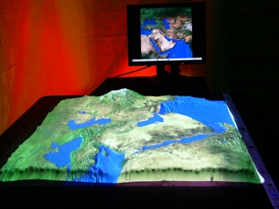
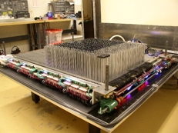
Creating 3D models: dynamic
XenoVision Mark III
TerrainTableTM included TouchTable capabilities
http://www.is.northropgrumman.com/products/terraintable/index.html

Slide 12
Tangible 3D interface
Notes:
Changes done in MIT system were unrealistic – more typical for surface coal mine or rock quarry. That meant that only relatively thin layer of clay was needed to make realistic changes

Slide 13
Two-way coupling with GIS
asynchronous
projector
color: attributes
GIS/IC
project with delay
3D scanner
surface: elevation
compute DEM
and its parameters
scan and stop
modify by hand
synchronous- real-time response
projector
color: attributes
GIS/IC
continuous loop
3D scanner
surface: elevation
compute DEM and
parameters instantly
scan
continuously
modify by hand

Slide 14
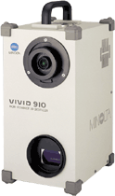
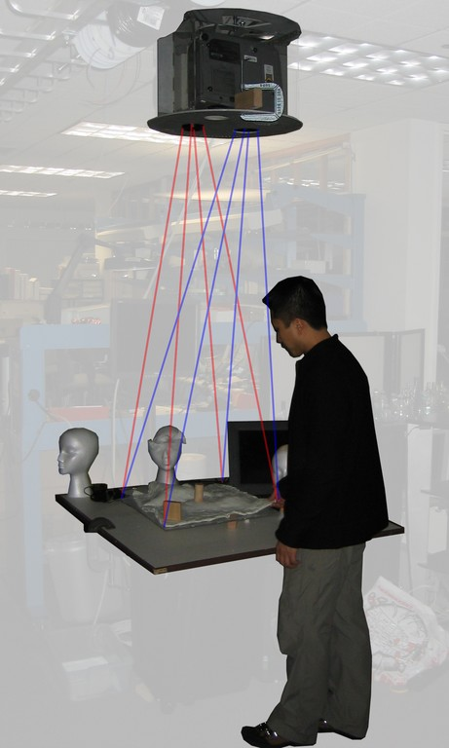
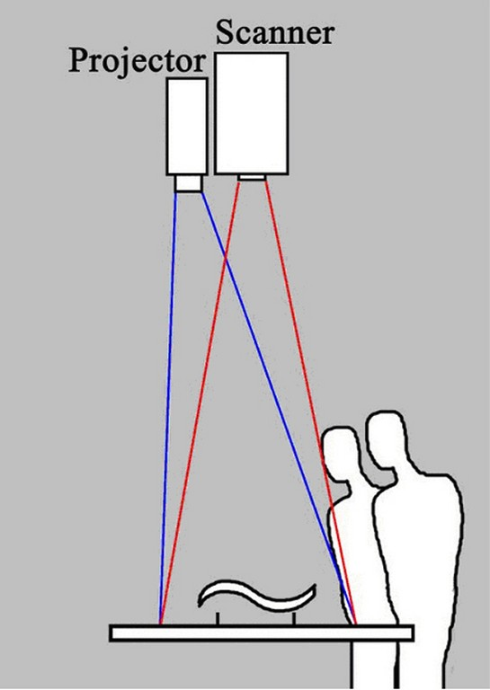
Two-way system: Illuminating Clay
MIT Media labs patents

Slide 15
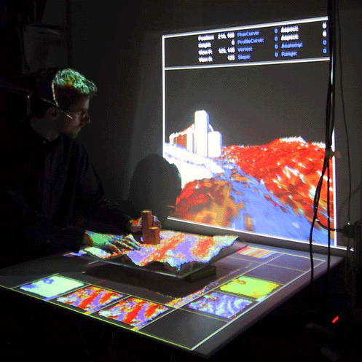
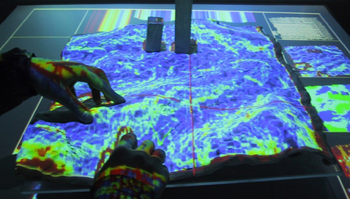
Working with Illuminating Clay
Combines virtual representation with solid model and 2D images
Re-computes and displays terrain parameters in near-real-time

Slide 16
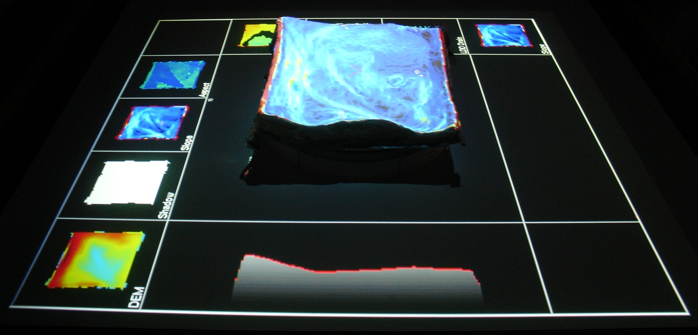
Model as Illuminating Clay
all parameters change in real-time
while the surface is modified
Aspect
Slope
Shadow
Elevation
Slope
Profile

Slide 17
First version – not stable enough

Slide 18
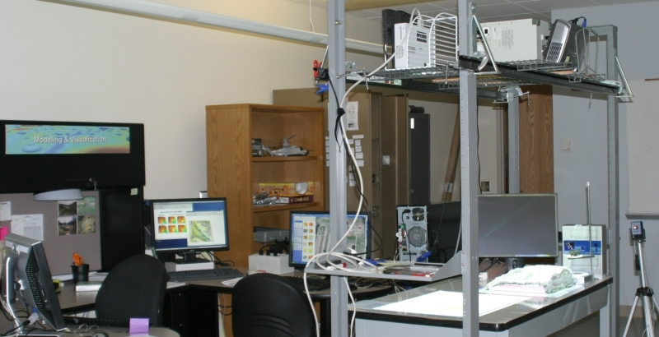
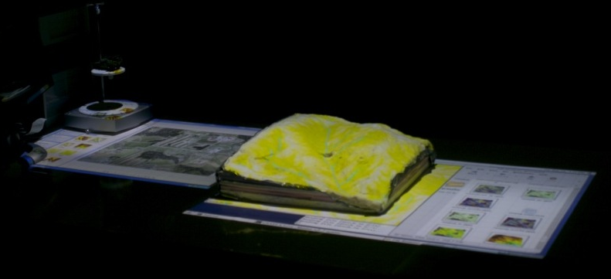
Building TanGIS at the VISSTA lab
3D scanners
projectors
3D display
workstations
web cameras
flexible models
System is linked to GIS (GRASS, ArcGIS)‏
GIS data and results of simulations based on
the scanned data are projected over the solid model.
Multipurpose facility at VISSTA Lab at ECE NCSU: Prof. Hamid Krim

Slide 19
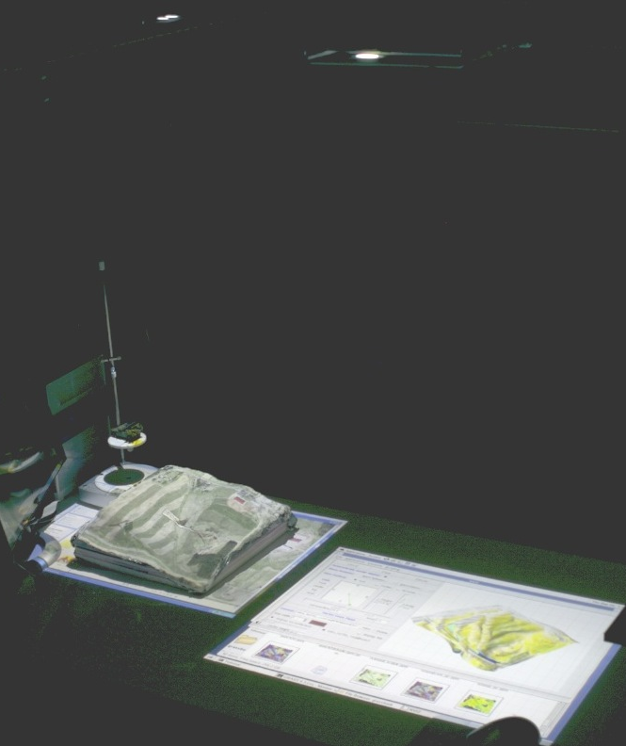
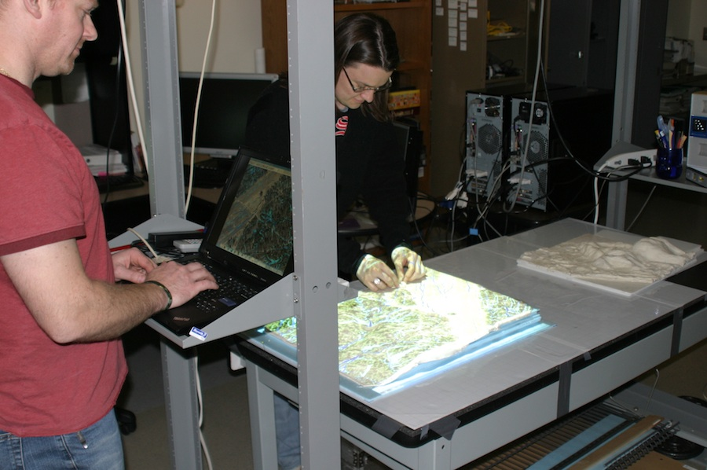
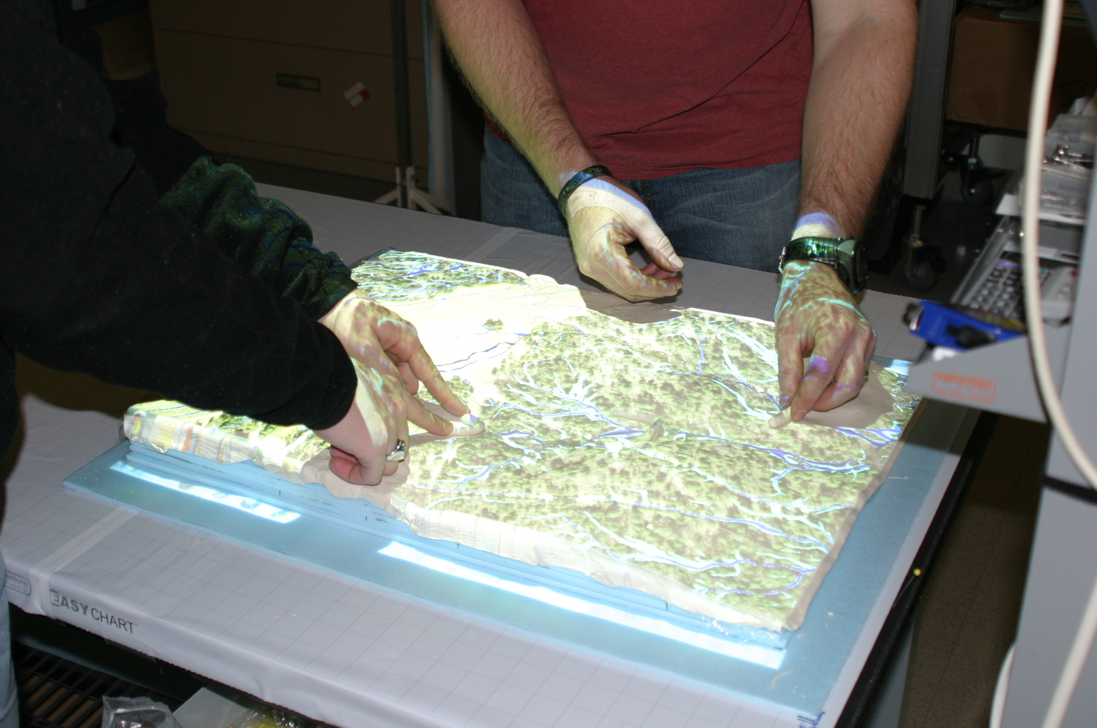
Tangible Geospatial Modeling System
3D laser scanner + projector
Modify model and scan it
flexible
model
with
projected
orthophoto
Compute DEM, run flow simulation,
project the results (img or animation)‏

Slide 20
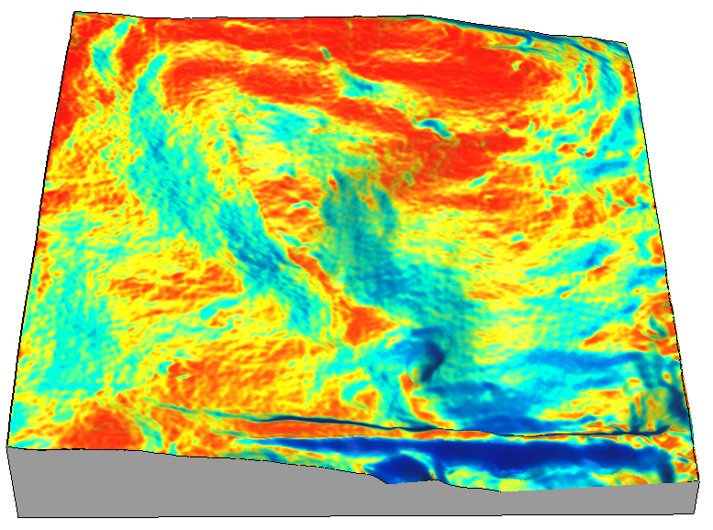
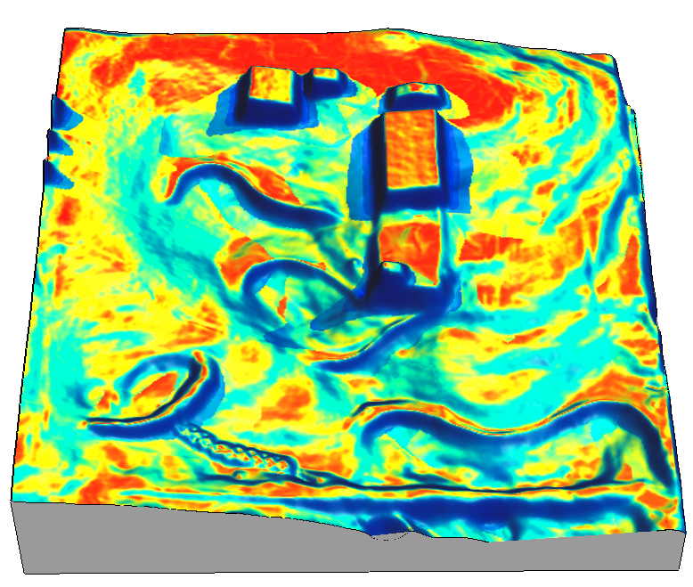
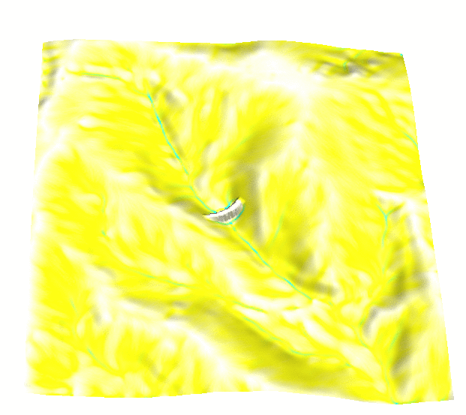
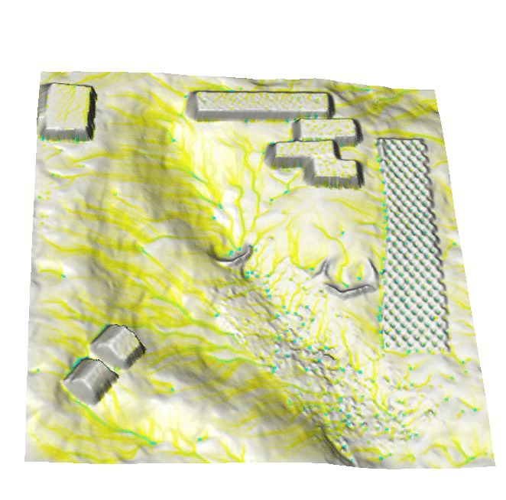
TanGeoMS: applications testing
solar radiation
Collaborative environment for
scenario exploration
3D sketching design and planning
testing methods and algorithms for modeling surface processes
Example: handling of rough surface in simulation of overland water flow
Old system: useful but too expensive to replicate
overland flow
LEGENDS!!!!!
0 200m

Slide 21
TanGeoMS: applications testing
video
http://www4.ncsu.edu/~hmitaso/wrriwork/tangis/tg1bak2_ed4_1min640.mov

Slide 22
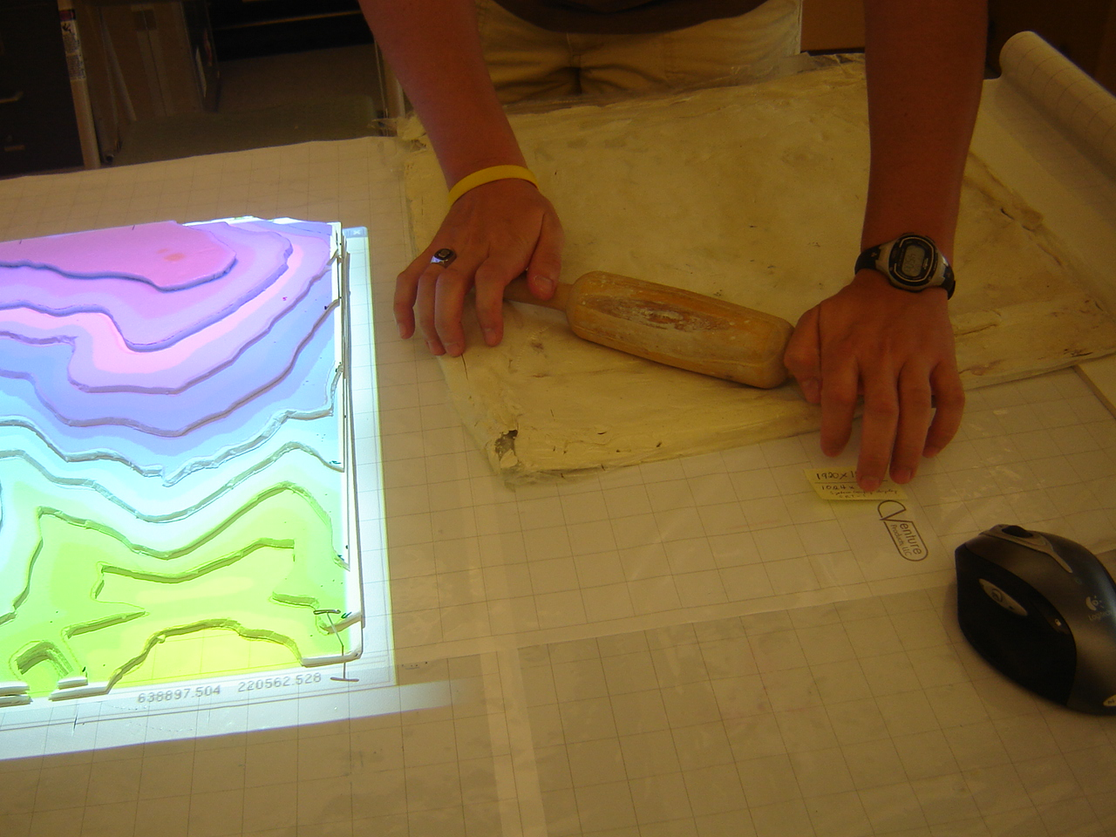
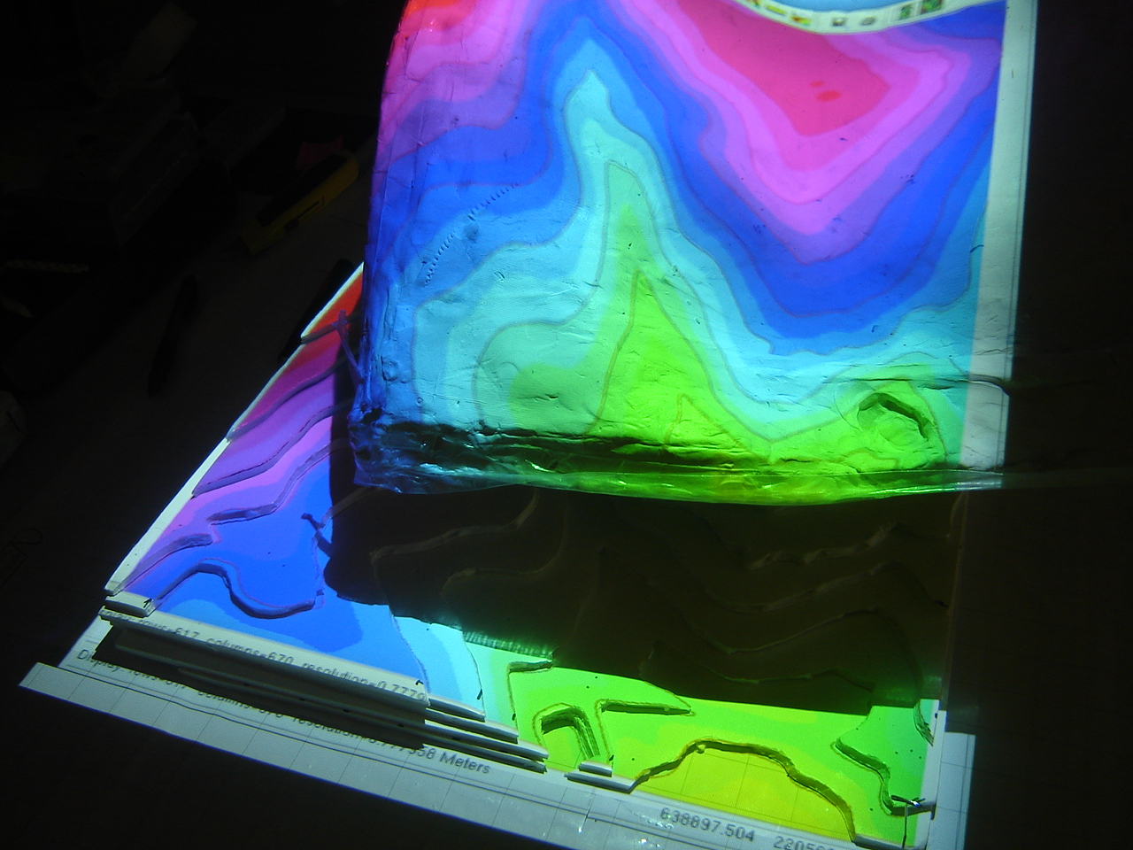
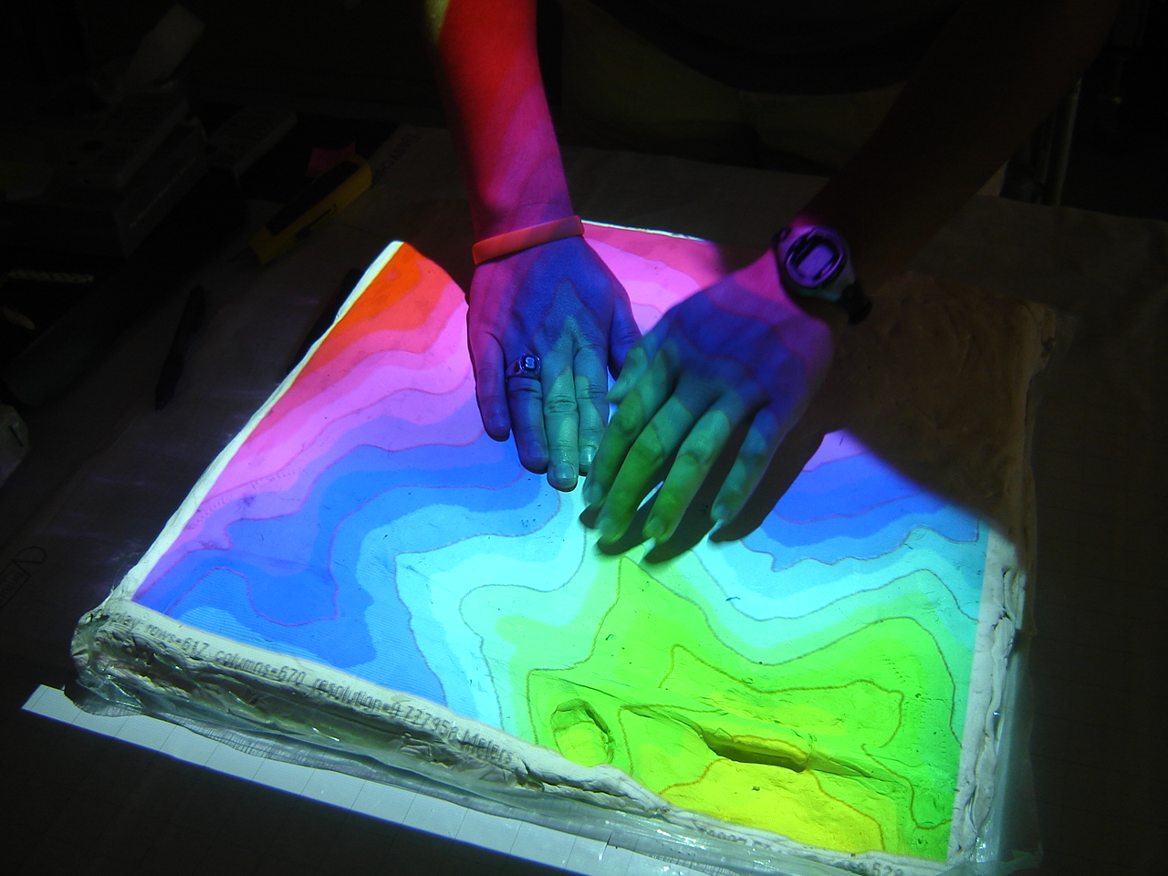
Tangeoms Erase and Reset “buttons”

Slide 23
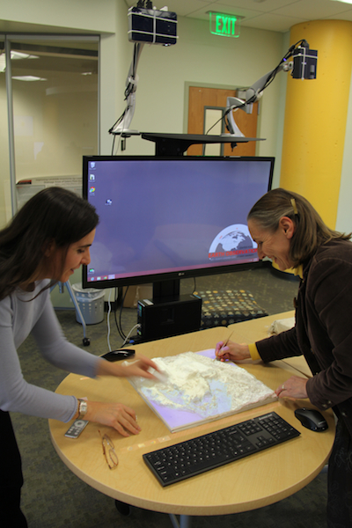
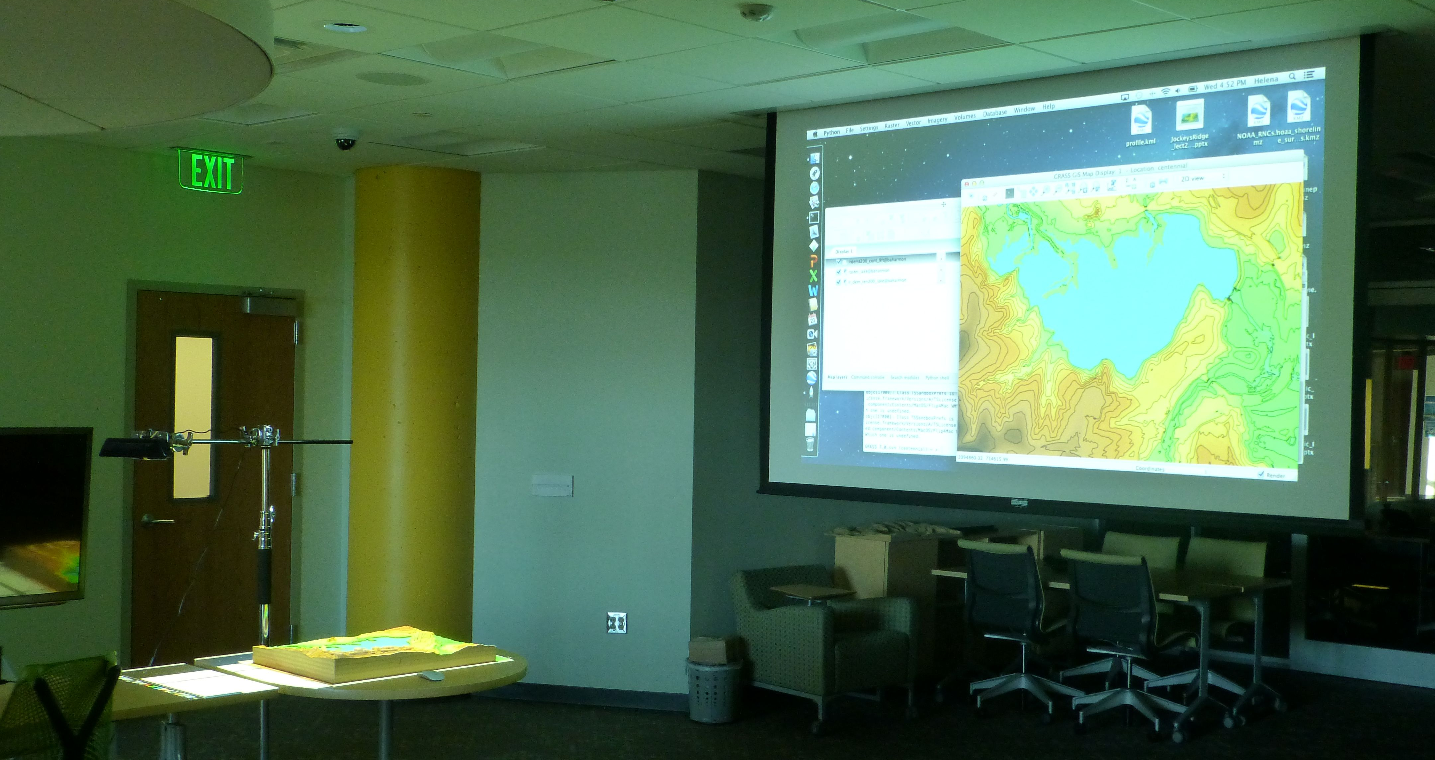
TanGeoMS current set up
Hardware:
$40,000 heavy laser scanner replaced by light $150 Kinect
projector(s)
printed, carved, sand molded models
smaller, more flexible, MUCH cheaper
personal and group set-up
similar systems: keckcaves.org, czech original

Slide 24
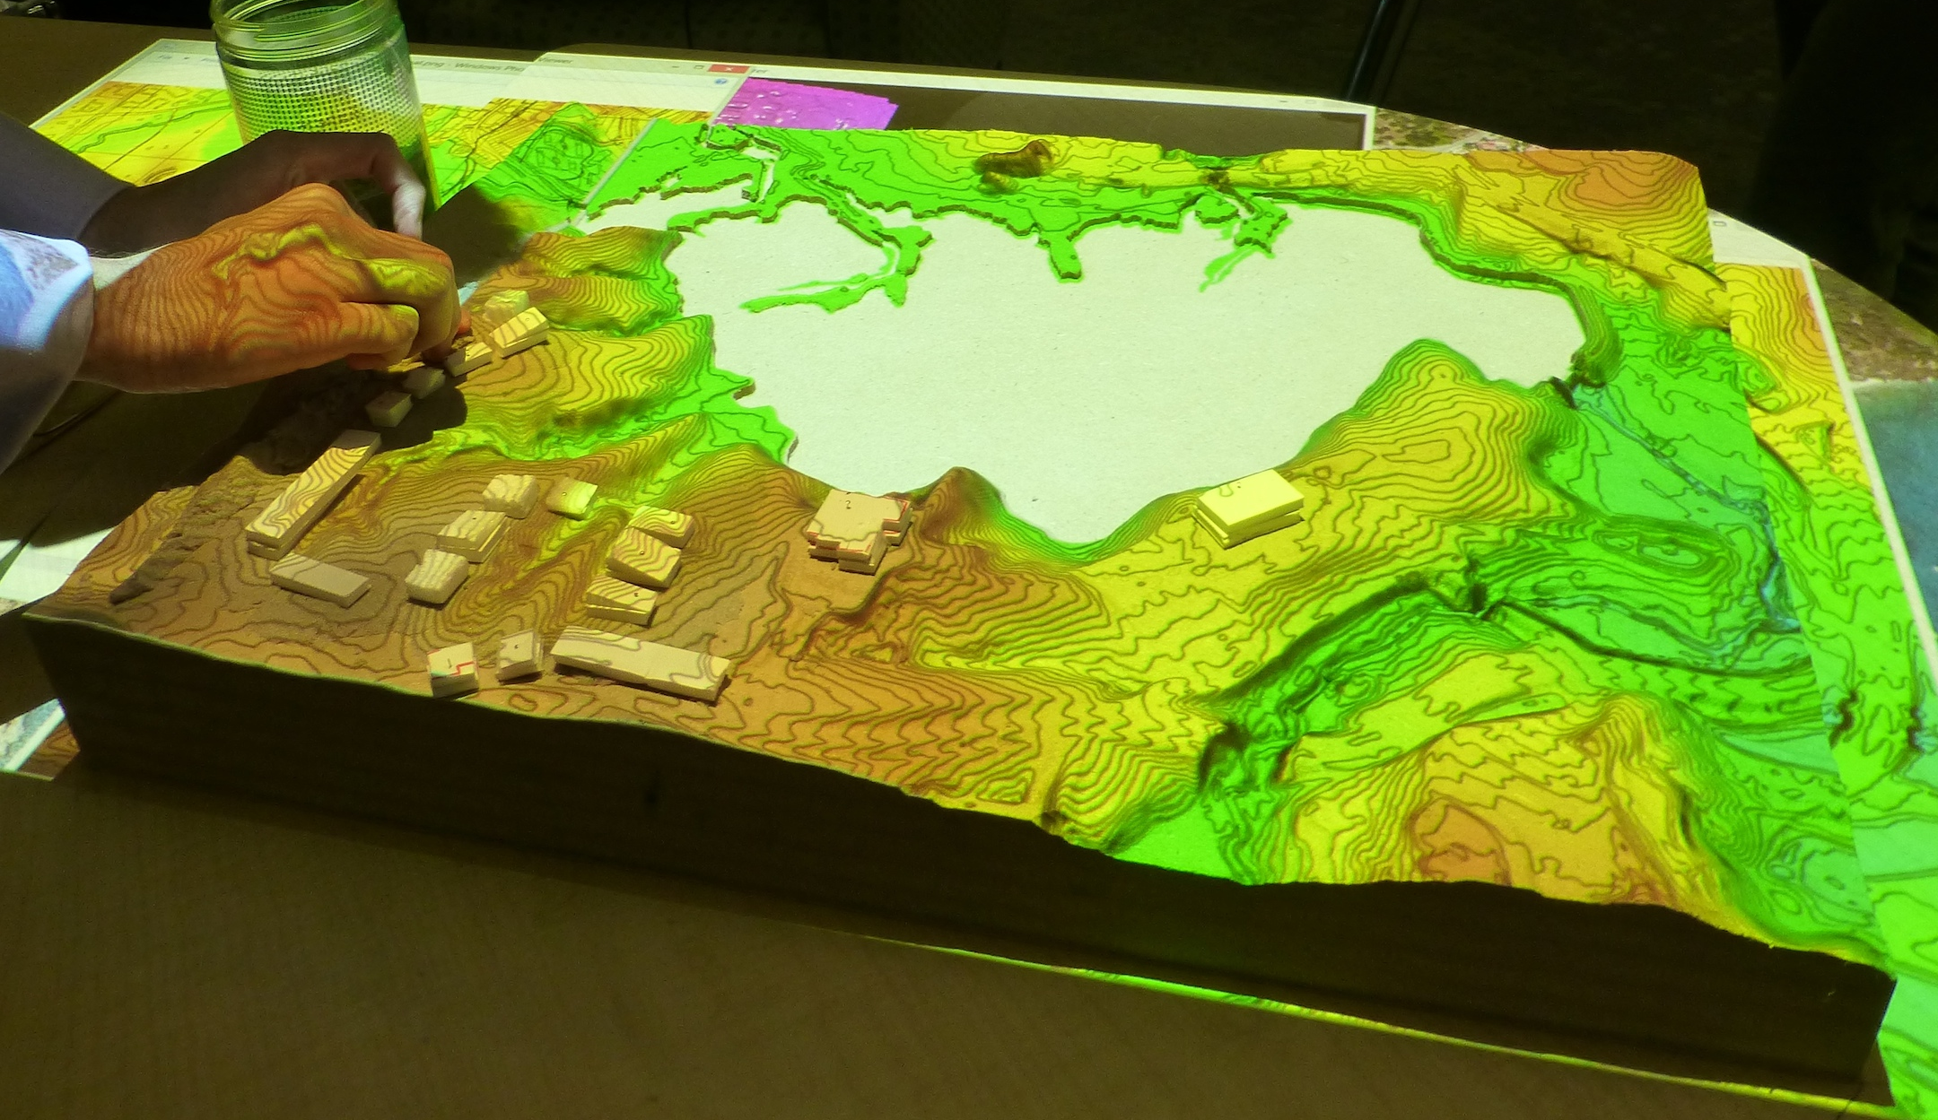
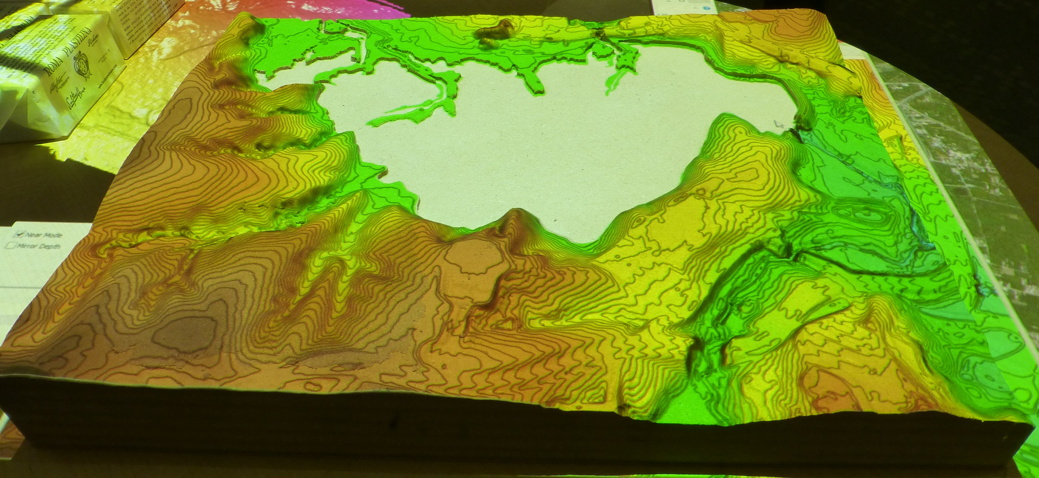
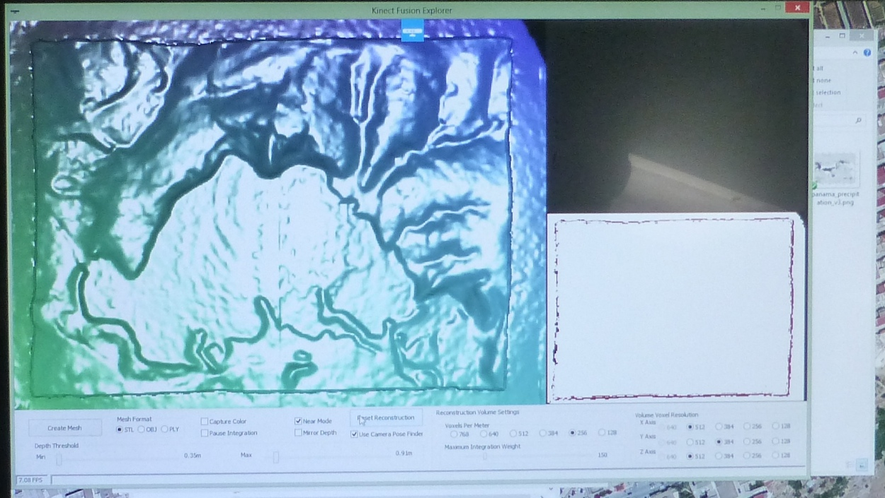
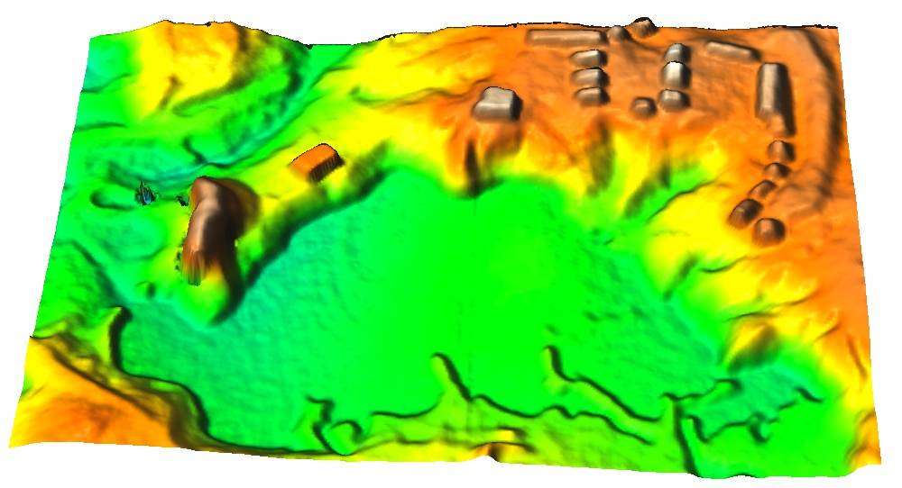
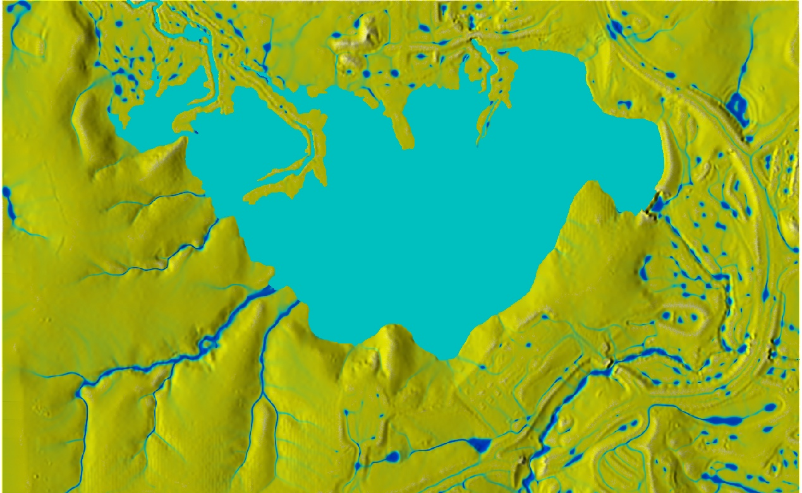
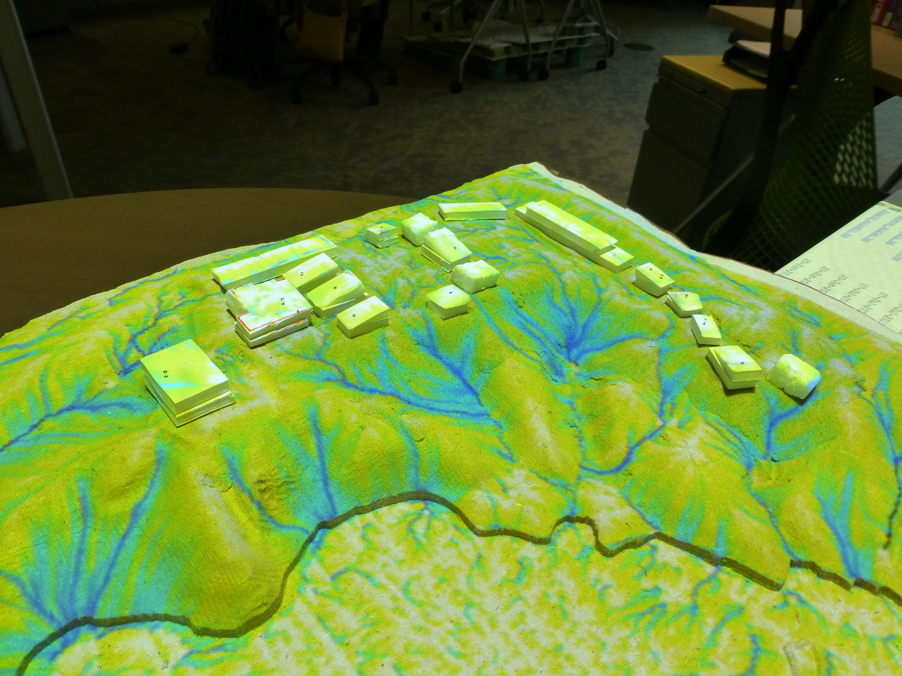
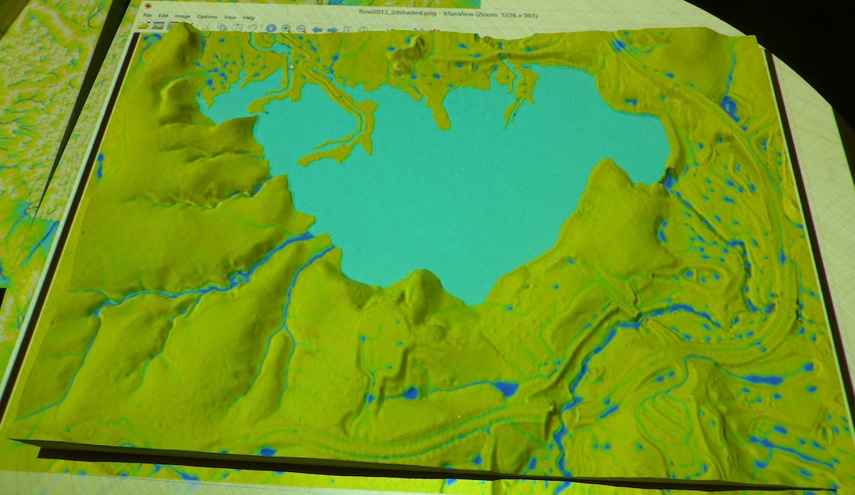
TanGeoMS workflow
modify model
scan
import into GRASS analyze, run model
project results: impact of topographic change
build model
project data: GRASS
scan model with Kinect
import into GRASS analyze, run model
project results

Slide 25
Scanning with Kinect
Scanning with Kinect
real-time response
high resolution
distortion and noise – minimized if kinect moves
Processing with Kinect Fusion SDK – export point cloud
alternative: PrimeSense

Slide 26
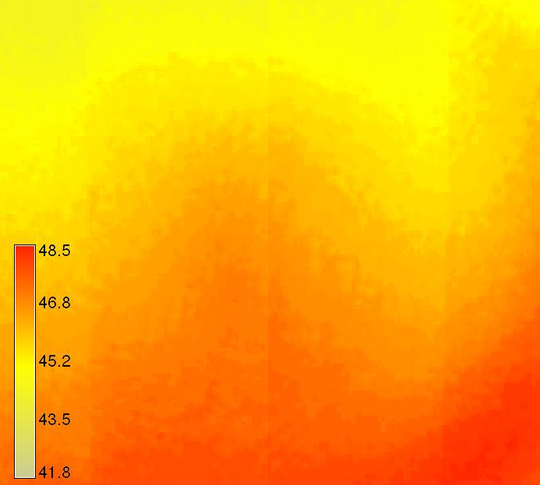
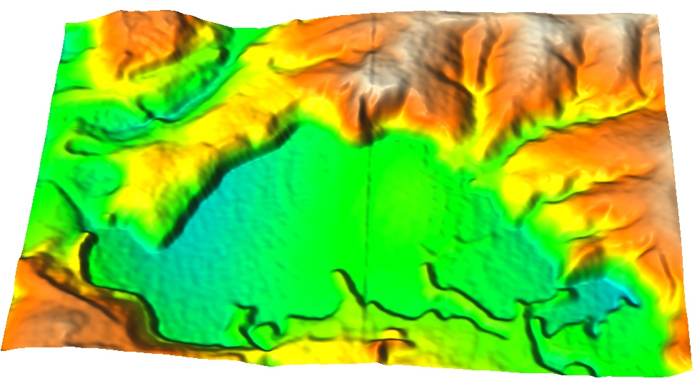
Processing Kinect scan in GIS
Georeferencing:
using ground control points
model scan aligned with projected coordinate system, shift and rescale
Correction for distortion:
scan planar surface as correction raster
subtract from scans

Slide 27
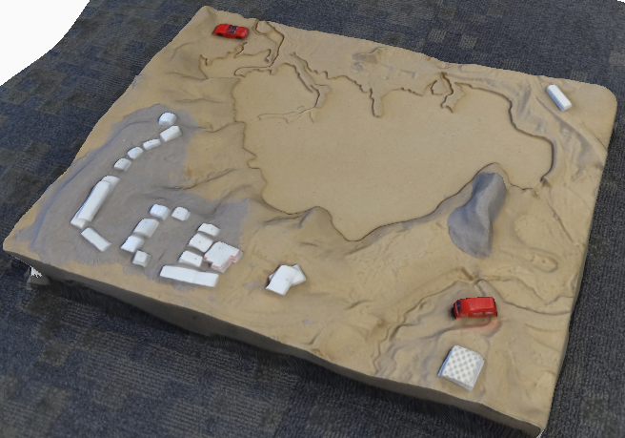
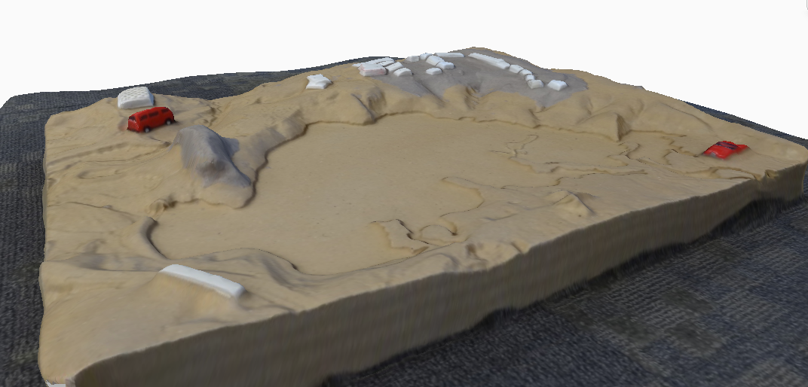
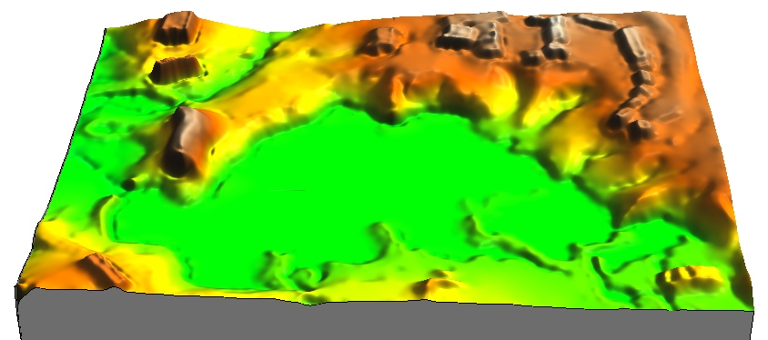
Scanning with digital camera
Acquire set of photos from different angles and distances
Process with Autodesk on-line tool 123D catch
export obj point cloud
Accuracy depends on number and position of images – can be excellent
Not real-time
Results from 20 images
123D viewer and GRASS

Slide 28
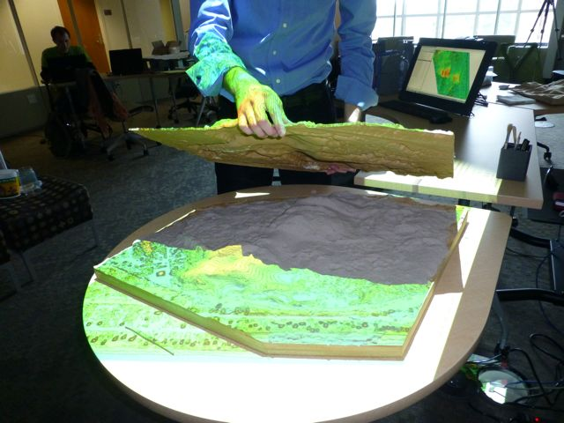
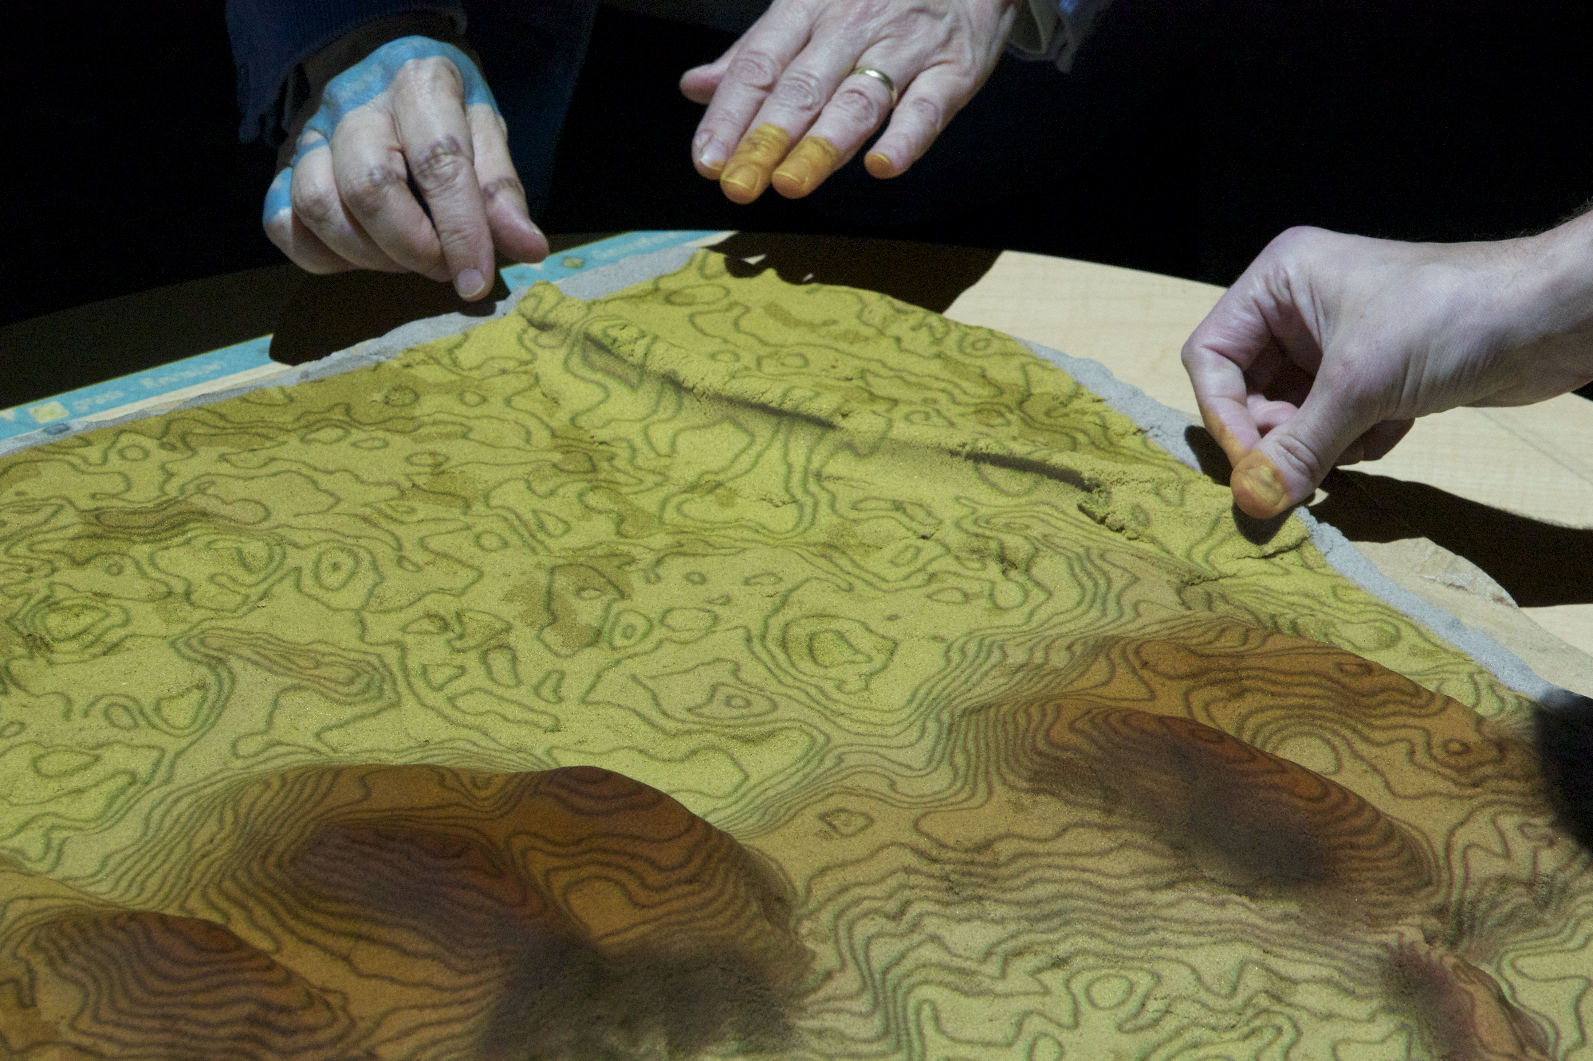
Jockey’s Ridge flooding and fire
Model with carved
core and sandy surface
layer based on 2008 DEM
Snapshots from
dynamic simulations of
inundation and fire spread

Slide 29
Indian Hill water flow and fire
Mammoth Cave
National Park:
analysis and
dynamic process
simulations
fire on table and flow over 3d model
slope

Slide 30
Research and Teaching with TanGIS
experiment with scanning of different materials
process point clouds of features with different geometries
test algorithms for analysis and simulations
explore and demonstrate spatial impacts of landscape change on runoff, erosion, solar irradiation, ...
Helena Mitasova, NCSU

Slide 31
Real-time data from terrestrial sensors:
ISCO samplers, Econet weather station
StarDot webcams,
Leica laser scanner + imagery
Integrated
dynamic virtual model
GIS:
OSGEO
software
stack
integration
analysis
modeling
Tangible GIS
Overlay and analyze:
- real-time data and
simulation results
over the physical model
Create:
new development scenarios
new BMP configurations
Multitemporal geospatial data:
multiple return airborne lidar, high resolution orthophoto, multispectral imagery

Slide 32
Conclusions
advanced time series modules in GRASS7 support analysis on 3D monitoring data and dynamic simulations
coupled GIS and TanGeoMS facilitates investigation and communication of topographic change impacts on landscape processes
new scanners and 3D printers offer cheaper, more flexible and portable solution
still many improvements needed to achieve high accuracy, real-time response for realistic simulations
we have enormous capabilities to collect data – now we need systems that facilitate designing solutions

Slide 33
Acknowledgment
Funding for this research has been provided
by US Army Research Office
GRASS development for this project was performed in the NCSU OSGeo Research and Education Laboratory: first North American lab in the worldwide network set up under OSGeo-ICA MOU
http://www.geoforall.org/
GRASS GIS

